Slide 1
The Importance of Family Advocacy
Mira Morton
Director of Government Relations
California Children’s Hospital Association

Slide 2
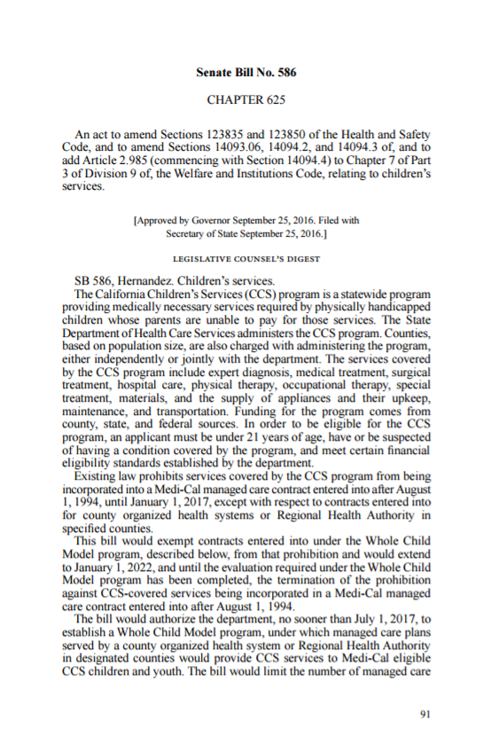
You Give Policy a Face

Slide 3
You Share Authentic Concerns
Will my daughter be able to keep her team of doctors?
How do I find the best pediatric surgeon for my child?
Who do I call when I have questions?

Slide 4
You Help Professional Advocates Prioritize
Continuity of Care
Care the Doctor Ordered
One Point of Contact
Transportation
Costs Covered

Slide 5
You Matter Most When the Stakes Are High

Slide 6
There Are Many Ways You Can Help
Share your story with a professional advocate or in writing.
Write letters to your representatives or advocacy organizations.
Testify at a hearing.
Visit lawmakers in their districts or the Capitol.
Join parent advisory committees.
Share your story with a friend.

