Slide 1
Medi-Cal Services for Children with Autism Spectrum Disorder & the Family Focused Model of Care

Slide 2
Agenda
Early and Periodic Screening Diagnostic and Treatments (EPSDT) and Mental Health Services for Medi-Cal Children
Autism Spectrum Disorder (ASD)
The referral process and eligibility for Behavior Health Treatments for ASD
The Family Focused Model of Care

Slide 3
Early and Periodic Screening, Diagnostic and Treatment
Section 1905(a)(4)(B) of the Social Security Act (SSA) for Early and Periodic Screening, Diagnostic and Treatment services (EPSDT)
Comprehensive array of preventive, diagnostic and treatment for low-income infants, children and adolescents under 21 years of age.
States are required to provide any Medicaid covered service listed in Section 1905(a) of the SSA that is determined to be medically necessary to correct or ameliorate any physical or behavioral conditions.
The EPSDT benefit is designed to ensure
that children receive early detection and preventive care
medically necessary treatment services

Slide 4
Adolescent BH Care – Health Plans
EPSDT for children under age 21, health plans must provide a broad range of medically necessary services that is expanded to include necessary health care, diagnostic services, treatment to correct or ameliorate defects and physical and mental illnesses and conditions discovered by the screening services, whether or not such services or items are covered under the state plan (DHCS APL 14-017)
Beginning September 2014, Behavioral Health Treatment/Applied Behavior Analysis (ABA) was added to health plan benefit under EPSDT
Therapeutic Behavioral Services (TBS) and specialty mental health services are available from county DMH
SUD treatment services are available under Drug Medi-Cal

Slide 5
Adolescent BH Care – County
EPSDT for children under age 21, county mental health plans shall provide or arrange for the provision of specialty mental health services (SMHS) for all Medi-Cal beneficiaries that meet medical necessity criteria for SMHS regardless whether or not they are enrolled in a health plan (MHSUDS Info notice 16-061)
The determination of medical necessity for SMHs is based on an assessment of the beneficiary by the county mental health plan
For children and youth, under EPSDT, the “impairment” criteria component of SMHS medical necessity is less stringent than it is for adults, therefore children with low levels of impairment may meet medical necessity criteria for SMHS (CA Code Reg, Tit 9, 1830.205 and 1830.210)
To receive SMHS, Medi-Cal children and youth must have a covered diagnosis and meet the following criteria:
Have a condition that would not be responsive to physical health care based on treatment; and
The services are necessary to correct or ameliorate a mental illness and condition discovered by a screening conducted by the health plan, the Child Health and Disability Prevention Program, or any qualified provider operating within the scope of his or her practice, as defined by state law regardless of whether or not that provider is a Medi-Cal provider

Slide 7
Check in

Slide 8
What is Autism?
Autistic disorder
Childhood disintegrative disorder
Pervasive developmental disorder-not otherwise specified (PDD-NOS)
Asperger syndrome.
DSM-5
Autism Spectrum Disorder (ASD)

Slide 9
Epidemiology of ASD
Prevalence
1 in 68 children, and 1 in every 42 boys will be diagnosed with ASD (Centers for Disease Control (CDC), 2014).
78 % increase in ASD diagnosis between the years of 2002 and 2008 (CDC, 2014).
Gender Differences (Mash, & Barkley, 2014)
4:1 male to female ratio
Males, compared to females, are 8.8 times more likely to have intellectual ability within the average range
Females with average IQ tend to show less symptoms of Autism than boys with similar IQ levels

Slide 10
Epidemiology of ASD
Age of Diagnoses
The median age of diagnosis is 44 months (CDC, 2014)
Epidemiological studies suggest that there are no differences by race or ethnicity in the actual prevalence or incidence of Autism (Bertrand et al., 2001; Mash, & Barkley, 2014).
Cultural Factors (CDC 2014; Emerson, Morrell, & Neece, 2016).
Caucasian children are approximately
30% more likely to be identified with ASD than non-Hispanic black children
50% more likely to be identified with ASD than Hispanic children.

Slide 11
Referral and Diagnoses
PCP’s screening yields positive or concerning results
PCP refers the child to a Regional Center that services the area in which the family resided for Comprehensive Diagnostic Evaluation (CDE)
Regional Centers
Non-profit Corporations that contract with D.D.S.
21 Regional Centers in California
7 Regional Centers in Los Angeles County
If the child is 2.5 years of age or older the caregiver should be referred for special education eligibility assessment as well

Slide 12
Referral and Diagnoses
Regional Center Completes the CDE
CDE Indicates Diagnoses of ASD and BHT/ABA is recommended by a licensed psychologist or physician
Member Contacts Health Plan to
Request Behavior Health Treatment
CDE does not indicates Diagnoses of ASD
Member does not meet the Eligibility for BHT services

Slide 13
Comprehensive Diagnostic Evaluation
Based on best practice guidelines:
Parent or caregiver interview
Review of relevant medical, psychological, and/or school records
Cognitive/developmental assessment
Direct play observation
Measurement of adaptive functioning
Comprehensive medical examination (by the primary care physician required under EPSDT)
7. Language assessment (could be by a speech language pathologist)
Sensory evaluation (could be by and occupational therapist)
If indicated, neurological and/or genetic assessment to rule out biological issues
(by a developmental pediatrician, pediatric neurologist, and/or geneticist)

Slide 14
Behavior Health Treatment (BHT)
Eligibility for BHT services
All of the following coverage criteria must be met
Be under 21 years of age
Have a diagnosis of ASD
Have a recommendation that evidence-based BHT services are medically necessary
a licensed physician and surgeon
a licensed psychologist
Be medically stable
Be without a need for 24-hour medical/nursing monitoring or procedures provided in a hospital or intermediate care facility for persons with intellectual disabilities (ICF/ID)

Slide 15
Medi-Cal covered BHT services must be
Medically necessary as defined by Welfare and Institutions Code Section 14132(v).
Delivered in accordance with the beneficiary’s Managed Care Plan (MCP – Health Plan) approved behavioral treatment plan
MCP-approved behavioral treatment must be developed and supervised by a contracted (or other form of agreement between the MCP and provider) and MCP-credentialed “qualified autism service provider,” as defined by H&S Code Section 1374.73(c)(3).
Board Certified Behavior Analyst
Licensed psychologist, marriage and family therapist, educational psychologist, clinical social worker, professional clinical counselor

Slide 16
Medical Necessity Criteria
From APL 14-011:
The following services do not meet medical necessity criteria, nor qualify
as Medi-Cal covered BHT services for reimbursement:
Therapy services rendered when continued clinical benefit is not expected
Services that are primarily respite, daycare or Educational in nature and
are used to reimburse a parent for participating in the treatment program
Custodial care: assist in daily living (bathing, dressing, eating, maintaining
personal hygiene and safety)

Slide 17
APL Specific Guidelines and Timeline
The qualified autism service provider should offer to meet with the member to conduct
an Functional Behavior Assessment (FBA), 15 days after the Health Plan makes its determination
The qualified autism service provider should offer to start the services,15 days after the Health Plan makes its determination based on the FBA report.
Prior authorized Applied Behavior Analysis (ABA) services by the MCP for a time period do not exceed 180 days
BHT services shall be rendered in accordance with the beneficiary’s treatment
plan. The treatment plan shall:
1- Be person centered and based upon individualized goal over a specific timeline
2- Be developed by a qualified autism service provider
3- Delineate both the frequency of baseline behaviors and the treatment planned to
address behaviors

Slide 18
APL Specific Guidelines
4- Identify long, intermediate and short term goals and objectives that are specific, behaviorally
defined, measurable and based upon clinical observation
5- Include outcome measurement assessment criteria that will be used to measure achievement
of behavior objectives
5- Using evidence based treatments
6- Include care coordination involving parents or caretakers, school
7- Include parent/caregiver training, support, and participation
8- Clearly identify the service type, number of hours of direct hours and supervision, and parent
participation necessary to achieve the plan’s goals and objectives, the frequency at which the
progress is reported and individual providers responsible for delivering the services
APL 14-11 Page 5-6

Slide 19
Established ABA Interventions for 22 and under (National Standards Project)
Behavioral Interventions
Cognitive Behavioral
Intervention Package
Modeling
Natural Teaching Strategies
Pivotal Response Training
Schedules
Scripting
Story-based Intervention
Comprehensive Behavioral
Treatment for Young Children
Language Training (Production)
Parent Training
Peer Training Package
Self-Management
Social Skills Package

Slide 20
Discontinuation of BHT Services
BHT services may be discontinued when
The treatment goals are achieved
Goals are not met; or
BHT is no longer medically necessary

Slide 21
Check in

Slide 22
Association of Mental and Physical Health Supports Integration Care
Mental illness is associated with chronic physical diseases
Mental illness
CVD
Diabetes
Obesity
Asthma
Epilepsy
Cancer
Mental illness is also associated with
Lower utilization of medical care
Reduced adherence to medication for chronic diseases
Increased risk of adverse health outcomes
CVD, cardiovascular disease.
Centers for Disease Control and Prevention. https://www.cdc.gov/mentalhealthsurveillance/fact_sheet.html. Accessed March 30, 2017.
Notes:
Key point: Mental illness is a substantial public health concern because it is associated with numerous chronic diseases that are often the focus of primary care.¹ Because of the association between chronic physical and mental illnesses, primary care physicians should consider mental health integration.²
Background:
The following are comorbidity estimates^{3,4}:
CVD: 2- to 3-fold increased risk in patients with mental illness
Diabetes: 1.2- to 5-fold higher risk in patients with mental illness; 8.9% in patients with major depressive disorder (vs 7.1% in those without)
Obesity: 42%-68%
Asthma: 17% in patients with major depressive disorder (vs 11.4% in those without)
References: 1. Mental illness surveillance among adults in the United States: fact sheet. Centers for Disease Control and Prevention. https://www.cdc.gov/mentalhealthsurveillance/ fact_sheet.html. Accessed March 30, 2017. 2. Auxier A, Runyan C, Mullin D, Mendenhall T, Young J, Kessler R. Behavioral health referrals and treatment initiation rates in integrated primary care: a Collaborative Care Research Network study. Transl Behav Med. 2012;2(3):337-344. 3. De Hert M, Correll CU, Bobes J, et al. Physical illness in patients with severe mental disorders. I. Prevalence, impact of medications and disparities in health care. World Psychiatry. 2011;10(1):52-77. 4. SAMHSA website. https://www.samhsa.gov/newsroom/press-announcements/201204100300. Accessed April 7, 2017.

Slide 23

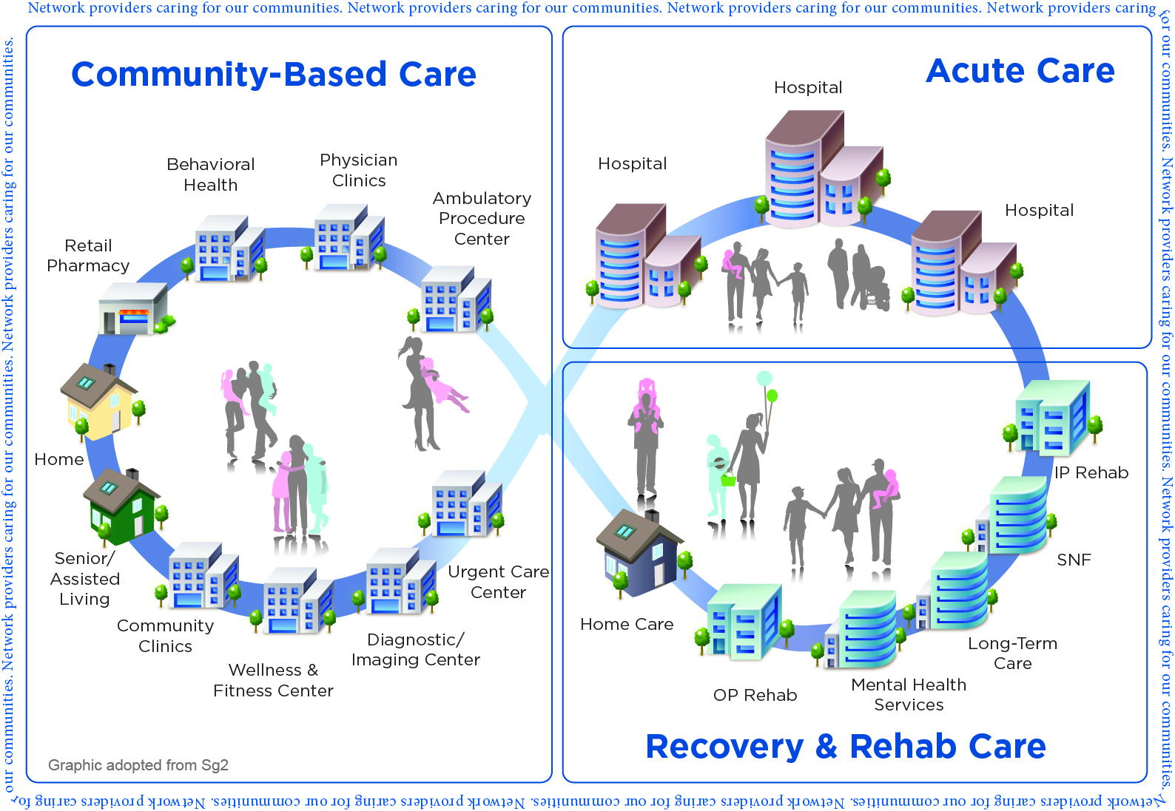



Behavioral Health Model of Care for Children & Adolescents
Community Based Human & Health Care
Acute Behavioral Health Care
Mental Health Unit
Co-occurring
Disorders
Unit
Chemical Dependency Recovery Center
Social Services
Agency (Foster Care, Court, etc)
Pediatricians/
Primary Care
Family Focused
Outpatient
Clinics
Children’s Hospital
Law Enforcement
Home & Family
Intensive Outpatient Programs
School/
Vocational Rehab
Community Organizations & Family
Resource Centers
Transitional Living Center
Partial Hospitalization Programs
Neighborhoods
Regional Centers/
CHDP
Church/
Clergy
Residential Treatment Programs
Behavioral Health Recovery & Rehab
Notes:
Deborah Proctor, president and CEO, said it best, “We are not on a mission to transform. We transform because of our Mission.”

Slide 24
Family-Focused Integrated Care Model
Care for the family
Mental Health, SUD and Primary Care Integration
Coordinate/linkage to community resources/programs
Same care team provided at different levels
“One Care Manager”

Slide 25
Q & A

