Slide 1




Notes:
Thank you all for joining us today to learn more about FVCA Project Leadership.
Introduce self:
I am now in my 4th year as PL Manager and have been with FVCA since project inception in 2013.
I was drawn to this work as a result of my experience as a parent of a child with special health care needs.
The purpose of this presentation is to provide you with
Brief background of project
The project goal
The need for parent leadership training in CA
Briefly describe the content of the training curriculum & methods for training implementation
Look at the results and show you what some grads are doing
Talk about our upcoming Training of Trainings workshop
Go over ways you, your agency, and the families you serve can benefit from this training
Allow time for you to ask questions about the training and the workshop

Slide 2
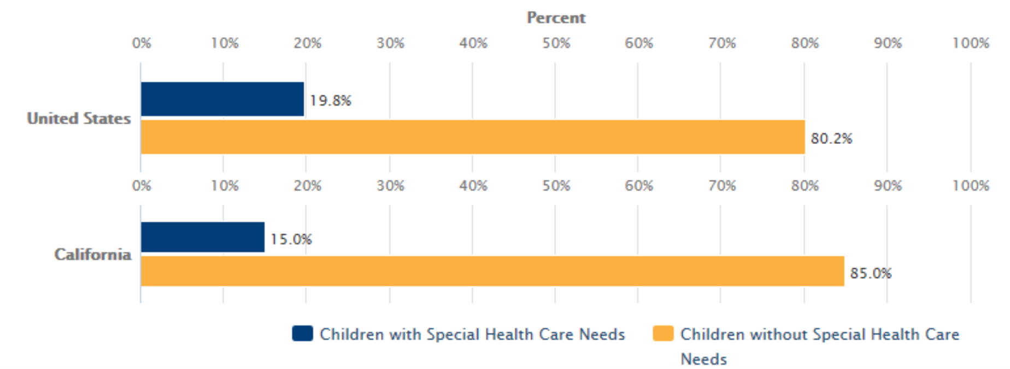
The Need
Children with Special Health Care Needs (California & U.S. Only): 2011-2012
(Special Needs Status: All)
Definition: Percentage of children ages 0-17 with and without special health care needs.
Data Source: As cited on kidsdata.org, Child and Adolescent Health Measurement Initiative. National Survey of Children's Health. Data Resource Center for Child and Adolescent Health, www.childhealthdata.org/learn/NSCH (June 2013).
2
Notes:
Why This Topic Is Important (FROM KIDS DATA)
Approx 1 million California children and youth in CA have a need for health care services of a type or amount beyond that required by children generally. Their ongoing health problems—physical, behavioral, or developmental—can affect their ability to function and participate in activities important to their education and social participation.
For more information on this topic, see kidsdata.org’s Research & Links section and our Program for Children with Special Health Care Needs site.
The Maternal and Child Health Bureau (MCHB) defines cshcn as “those who have or are at increased risk for a chronic physical, developmental, behavioral, or emotional condition and who also require health and related services of a type or amount beyond that required by children generally..”
An estimated 1 in 10 – approximately 1 million – California children under age 18 has a special health care need using this definition.
As the Lucile Packard Foundation for Children’s Health has reported, California fares poorly in comparison with other states on many federally mandated (MCHB) core outcomes. A few examples:
Nearly half of California children with special health care needs do not receive effective care coordination, which is a central component of quality health care. The state ranks 46th in the nation on this measure.
More than 40% of California’s children with complex health needs have a difficult time obtaining community-based services, such as finding doctors and scheduling appointments.
More than 4 in 5 children with special health care needs in California do not receive care that meets federal minimum quality standards.
California ranks last in the nation on the percentage of children with special health care needs whose families experience shared decision-making with health care providers.
Children with Special Health Care Needs (CSHCN): A Profile of Key Issues in California, Child and Adolescent Health Measurement Initiative, Lucile Packard Foundation for Children’s Health, January 2013 accessed 4.14.15 at http://cshcn.wpengine.netdnacdn.com/wp-content/uploads/2013/01/Christy-report_01-22-13.pdf
These poor rankings are not surprising given the multiple health service systems in California for CYSHCN that are extremely complex and difficult to navigate, even for many professionals in the field.
Families of children and youth with special health care needs (CYSHCN) have had significant real-world experiences that could help make health care policies and administration more family-centered and culturally competent but many lack the training, experience, knowledge of systems / govt, how policy decisions are made and confidence to make their voices heard. they need to engage in advocacy on behalf of their children
Project Leadership was designed and implemented to address these barriers and enhance family participation in programs and policy-making in California.

Slide 3
The Goal
Increase the number of family members of children and youth with special health care needs (CYSHCN) who are prepared and supported to become advocates for health care policy and service improvements.
Notes:
I will start by giving you a brief background of how and why Family Voices developed this training program. Back in 2004, FVCA received funding from the Marguerite Casey Foundation to develop a Leadership Training that would help prepare families to effectively advocate for their children with special health care needs (CSHCN) by educating policymakers and legislators about their children. Individual chapters were presented by FVCA council members at various conferences or at council member agencies.
Then in 2013 FVCA was awarded a grant from the Lucile Packard Foundation for Children’s Health to implement a pilot training series and we are now in our fourth phase of funding with the foundation. We are grateful for their ongoing support of this project.
How do we do this?
Project Leadership features a comprehensive training curriculum, paired with mentoring and support, that prepares families to build partnerships with professionals, take on leadership roles and engage in public policy advocacy on behalf of CYSHCN.
We train families to have their voices heard in an effective way whether serving on groups, talking to legislators, telling their stories to the media and we provide the support needed to do this.
Advocates = have their voices heard; recommend / give input; speak on behalf of all CYSHCN
(not limited to lobbying / legislation)

Slide 4
Content
1: Knowing the Past to Change the Future
History and Purpose of Advocacy
2: Rules of the Road
Systems, Laws, and Entitlements
3: Becoming a Mover and Shaker
Working with Decision-Makers for Change
4: Playing Well with Others
Enhancing Communication
5: Telling Your Story
Developing and Presenting Stories to Others
6: Ways You Can Serve
Participating on Decision Making Bodies
7: Solidifying Partnerships
Connecting with Local Change Makers
Notes:
The Project Leadership seven-session (28 hours) training curriculum AVAILABLE IN BOTH ENGLISH AND SPANISH is designed to be comprehensive and responsive to family needs. Can be used as seven session series or as individual workshops. Different agencies schedule the 7 sessions differently – weekly, monthly, bi-weekly, over 4 Saturdays, etc.
I won’t read through the table of contents, but want to emphasize that the overarching theme is partnership with professionals / decision-makers – we cover history of advocacy, systems and laws pertaining to CSHCN / disabilities, legislative process, communication skills, telling your story effectively, ways to participate.
Facilitation: Sessions are designed to be dynamic and interactive giving participants opportunities to learn with and from each other.
Action Plan: As a core feature of the training, participants develop an Action Plan to address issues affecting their own families or families of CYSHCN in general.
Homework: Participants receive resource materials and “homework” as well as ongoing support, technical assistance, and mentorship at both the local and statewide levels. Families are encouraged to use what they have learned in the curriculum outside in the real world and bring back their experiences to the group at the next meeting. For example, one homework assignment asks participants to research and attend a group, committee, or task force. At the class meeting they are encouraged to talk about what works, the challenges and how they might better be able to participate.
Important to note that the curriculum is adaptable to specific target populations or geographic areas. One agency adapted it to parents of children birth to five. Another agency is planning to modify the curriculum to local area.
Because of interest we have received from out of state agencies, also looking at adaptability to other states.

Slide 5
Structure & Staffing
FVCA Council
Project Director
Project Leadership Manager
Host Site Trainer / Mentor
Host Site Support Staff
Notes:
Staffing
FVCA Council Member Agencies: General oversight
Project Director: Juno Duenas, Support for Families
Project Leadership Manager manages all project activities statewide, including facilitating training of trainers workshop and providing mentoring and support to host agencies.
trains regional Trainers and provides ongoing technical assistance and support
links each Trainer and local project participants to statewide opportunities for advocacy and any additional relevant training
maintains a database of opportunities for family participation and a separate database to track families who are available to partner;
compiles statewide data, reports, and articles; and disseminates project information and results.
The Trainer is responsible for coordinating all aspects of the training in his/her region, including:
outreach to and recruitment of participants;
planning all meeting logistics such as scheduling, interpreting, and childcare;
conducting the training using the curriculum resources;
and evaluating program components and impact using the curriculum’s surveys.
The Trainer helps to identify health-related committees and task forces in his/her region and helps project participants become involved.
S/he assists in developing reports and articles about project activities in the region and maintains regular communication with the Project Manager.
Once the training is completed, the trainer continues to mentor graduates as they pursue leadership opportunities in the area.
Host Site Support Staff: It is helpful to trainer if there are members of host site staff who can provide support with some of the logistical details.

Slide 6
Recruitment & Retention
Target Population: Caregivers of CYSHCN, disabilities, or mental health / behavioral health issues
Outreach:
Wide variety of agencies, organizations, and hospitals
Incentives:
Food, Childcare, Stipends
Accommodating Families
Scheduling / Make-up Sessions
Participation Agreement
Certificate of Completion
Notes:
Target Population: caregivers of children with special health care needs, disabilities, or mental health / behavioral health issues. Caregivers have included moms, dads, foster parents, adoptive parents, and grandparents.
Outreach: Recruitment efforts by local host sites have involved outreach to local agencies and organizations serving cshcn, disabilities, mental / behavorial health issues.
To a wide variety of agencies, organizations, and hospitals, including Family Resource Centers, support groups, local California Children’s Services, and pediatric specialty care clinics. This strategy resulted in a diverse group of graduates in terms of race, gender, children’s diagnoses, family structure, and languages, as well as educational, professional and socio-economic backgrounds.
Incentives: Families received stipends upon completion of all seven sessions of the training as well as free childcare and food during the training; these incentives proved very successful in both recruitment and retention of participants. Having said that, some agencies have been successful without these incentives.
Scheduling also key in success of recruitment and retention:
Seven 4-hour sessions: In order to accommodate a range of family schedules and address the needs of working parents, FVCA recommends offering the training during days / times that work for your target group. It has been offered on weekends, evenings, weekdays, weekly, monthly, bi-weekly, etc. Flexibility in how the series is structured.
Also flexibility with length of each session: the curriculum is designed to cover the material in each chapter in three hours. However, offering four-hour sessions is optimal, allowing sufficient time for breaks.
Accommodating families: Important to note how challenging it can be for parents of CSHCN to actually complete trainings etc because we are so busy coordinating services/taking care of our kids and this model has so much support, it has been effective. If a parent can’t make a training we follow up with them for a make up session, meet and go over the curriculum – participation agreement allowed one absence and make up and still be eligible to receive stipend.
Has been offered in as two simultaneous series (i.e., one group that meets on a weekday and another group that meets on Saturdays) – allowing for make up sessions and provides needed flexibility to families coping with the special needs of their children.
Participation Agreement: Participants are asked to sign a letter clarifying their responsibilities as part of the project and identifying the time and activities that they are committing to;
Certificate of Completion: they also receive a certificate of completion at the end of the training.
We have seen success with these practices and recommend implementing these strategies as appropriate to your agency
.

Slide 7
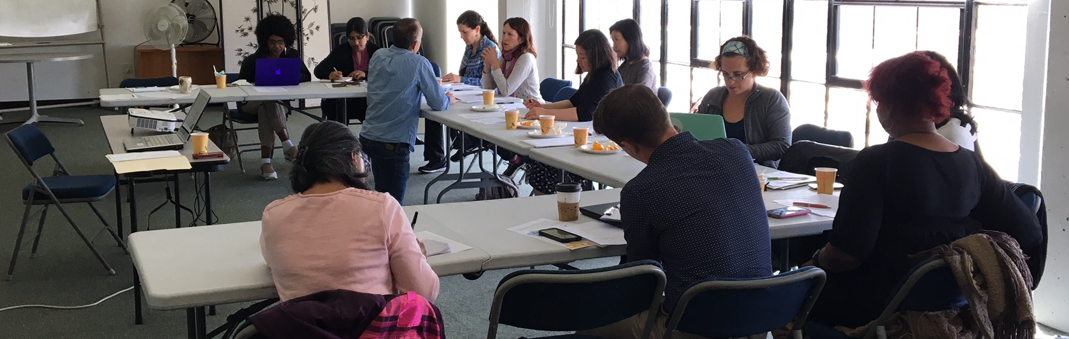
Mentoring & Support
Ongoing Individual Mentoring
Quarterly Group Mentoring
Online Advocacy Community
Annual Alumni Meeting
Support from local host site / FRC
Notes:
Mentoring and Support are key components for both parent / caregiver participants and project trainers.
Even after completing a leadership training program, parents can find it hard to put their training into practice. They may not know where to begin to find involvement opportunities or what they need to do to make their voices heard. And many without experience in advocacy lack the confidence in their ability to partner with decision-makers without ongoing support.
Individual Mentoring: The Trainer is available to provide mentorship to participants / graduates on an individual level in person, by telephone, or via email throughout the training series as well as after graduation. The Project Manager (me) is also available to offer mentoring and support to both graduates and trainers statewide.
Quarterly Group Mentoring: Offer webinars or conference calls to both graduates and trainers. Some recent quarterly webinars have included:
An attorney from DRC on the topic of upcoming policy changes regarding DD services.
A nationally recognized parent leader, Rylin Rodgers, on challenges and successes of her journey as well as tips for success.
A consultant for CCHA on federal health care reform efforts and effective ways to express concerns / tell your story to legislators on this issue
Online Advocacy Community: During the second year of the project, FVCA developed a Project Leadership learning / advocacy community — an online forum moderated by the Project Manager — so that program graduates from all over the state can learn from and support each other. The goal is to create a forum for sharing resources, events, articles, current issues, and important legislation information among all Project Leadership graduates. This group serves as an additional forum in which Trainers can provide support and peer mentorship can thrive.
Annual Alumni Meeting: Nor Cal and SoCal. Purpose is to connect, network, stay informed on current issues affecting CSHCN. Refresh / review skills from training.
Support from FRC / host site Staff: A key feature of the training methodology is the provision of support services addressing participant needs and ongoing mentorship, ensuring that families remain engaged in advocacy work. Since the trainings are housed at Family Resource Centers, families have access to individualized support from staff.
Health Summit (not shown here also an opportunity for grads and trainers to connect.)
Photo shows special session with Dan Weintraub founder and editor of California Health Report. Art of Writing an opinion article. Two grads articles have been published in CA Health Report.

Slide 8
Databases
Database of Family Leaders (Project Graduates)
  Areas of expertise / experience
  Advocacy / Leadership Interests
  Advocacy / Leadership Activities
Opportunity Database
  Local
  Regional
  State
  National
Notes:
Databases
As part of the mentorship component, during the pilot year I developed and continue to maintain two databases:
a database of opportunities in which families can participate
Opportunity Database
Local: hospital advisory, CCS Family Advisory Groups, County Mental Health Advisory, SELPA CAC
Regional: SCDD, Regional Centers
State: CCS AG, Medi-Cal Children's Health Advisory Panel
National: AAP
a database of family leaders (project graduates) which identifies graduates’ areas of expertise and experiences related to CYSHCN and tracks their advocacy activities. This information builds FVCA’s capacity to be responsive to media requests and requests for family participation on committees and task forces at the local, regional, and state levels.
MATCHING
Examples of use:
A news outlet looking to interview a family of CSHCN who transitioned from Healthy Families to Medi-Cal contacted FVCA. We can use our database to quickly identify families who used these systems & connect them to the media.
State looking for families to join TWG as part of CCS Redesign.
Parent who is former foster youth looking to join council / committee and be the voice of foster youth

Slide 9
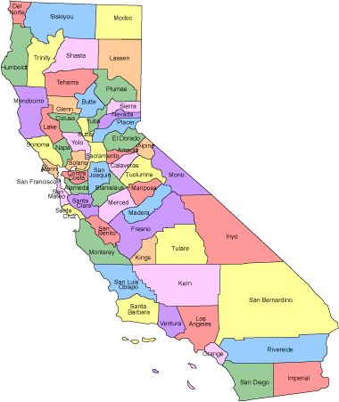
Results
144 graduates in 7 counties
39 trained trainers in 15 counties (19 agencies)
Notes:
Project Implementation
Counties currently implementing or planning to implement:
Kern, Sacramento, Santa Clara, Tuolomne
Repeat sites: Alameda, SFCD, LA, San Bernardino
Have seen models for partnering among agencies:
LA: FRC and SCDD
Santa Barbara: FRC and RC
San Berna: FRC, SCDD, RC
Others:
Santa Cruz, San Mateo,

Slide 10
Independent Evaluation
Participants’ confidence in their ability to advocate, their leadership skills, and their experiences with advocacy showed significant improvement.
Participants showed significant, positive changes on measures of empowerment for accessing services for children.
Participants felt better prepared to continue to advocate for their children and for systems change.
Evaluation Report: Project Leadership, Leslie S. Linton, Terry Conway, Christine Edwards, Health Policy Consulting Group, May 2014
Notes:
During our pilot year in 2013, Health Policy Consulting Group (HPCG) conducted an independent evaluation of the project using the Family Empowerment Scale, surveys and interviews of participants.
The independent evaluation found that program graduates from diverse backgrounds, when tested at the end of their seven-session training session, showed significant improvement in their confidence in their ability to advocate, leadership skills, and their experiences with advocacy
From surveys before and after training, participants showed significant, positive changes on measures of empowerment for accessing services for children.
Additionally, the evaluators found participants to be better prepared to continue to advocate for their children and for systems change
FOLLOW UP SURVEY COMPARISON

Slide 11
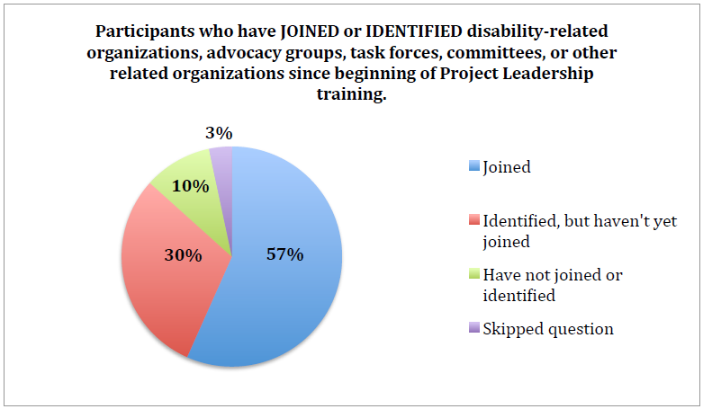
Independent Evaluation
Evaluation Report: Project Leadership, Leslie S. Linton, Terry Conway, Christine Edwards, Health Policy Consulting Group, May 2014
Notes:
This chart reflects one of our key goals which is to help parents join committees, councils, other groups where they can represent parents of CSHCN. Close to 90%
We will look at some of these groups in a moment as well as results from current survey…

Slide 12
What are Graduates Doing?
Notes:
The vision of FVCA’s Project Leadership is that families of CYSHCN and consumers will be able to effect health care program improvement, systems change, and lasting reforms. Graduates are:
Serving on health care- / disability-related groups or decision-making bodies
Meeting with local and state policymakers
Providing public testimony
Telling their stories to the media

Slide 13
  Serving on groups
California Children’s Services:
  Family-Centered Care Committees (county level)
  Needs Assessment (state level)
  Advisory Group (state level)
  Redesign Technical Work Groups (state level)
Children’s Regional Integrated Service System (regional)
Mental Health Advisory Board (local level)
Medi-Cal Children's Health Advisory Panel (state level)
Fatherhood Initiative Workgroup (local level)
Hospital Family Advisory Councils
Help Me Grow
Head Start
SELPA Community Advisory Committee
State Council on Developmental Disabilities
Regional Center
Notes:
Some examples of types of committees / groups graduates are involved in from local to state level. A WIDE VARIETY.
RECENT SURVEY RESULTS: 75% HAVE SERVED ON A COMMITTEE / GROUP
Alameda County Committee on Children with Special Needs
CCS Alameda County Family Centered Care Committee
Title V CCS Needs Assessment
CCS Redesign Technical Work Groups
Children’s Hospital Oakland Family Advisory Council
Children’s Regional Integrated Service System
San Diego Head Start Policy Committee
Help Me Grow (Alameda and San Francisco)
Kaiser Patient & Family Centered Care Advisory Council
SF City & County Fatherhood Initiative Workgroup
San Francisco Mental Health Board
SELPA Community Advisory Committee (various counties)
Support for Families Board
Center for Youth Wellness Advisory Council
UC Berkeley MCH CSHCN Conference – Parent Panel
FVCA Health Summit & Legislative Day / Health Summit Advisory Committee

Slide 14
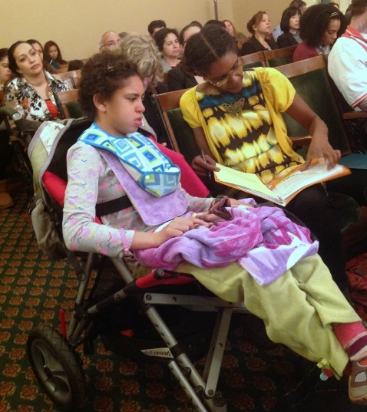
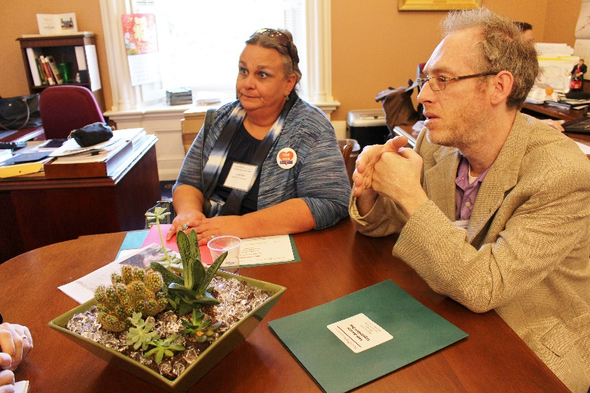
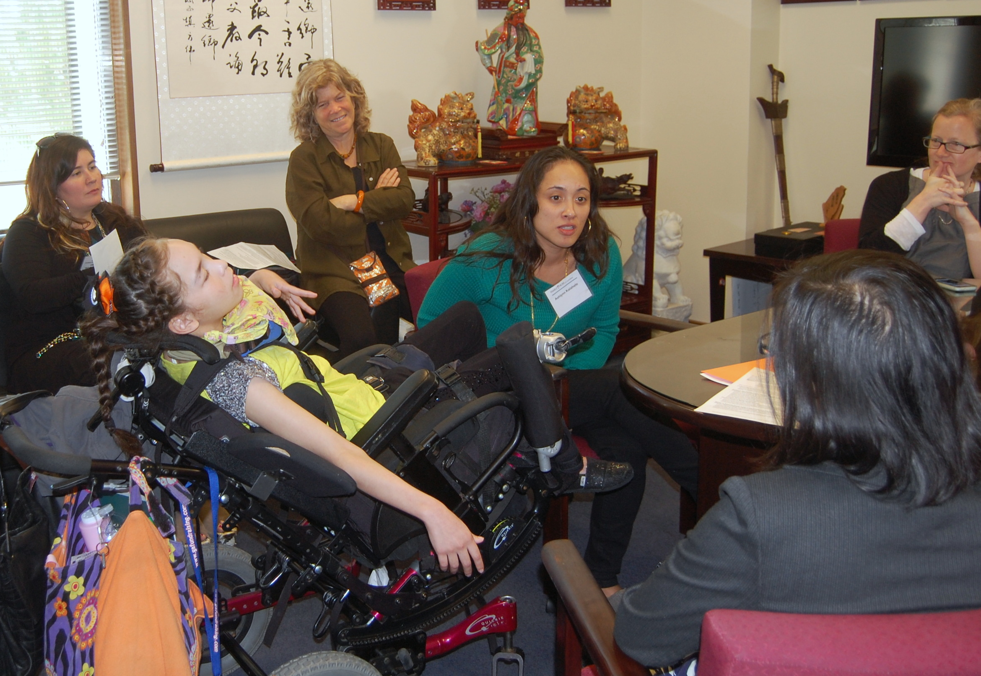
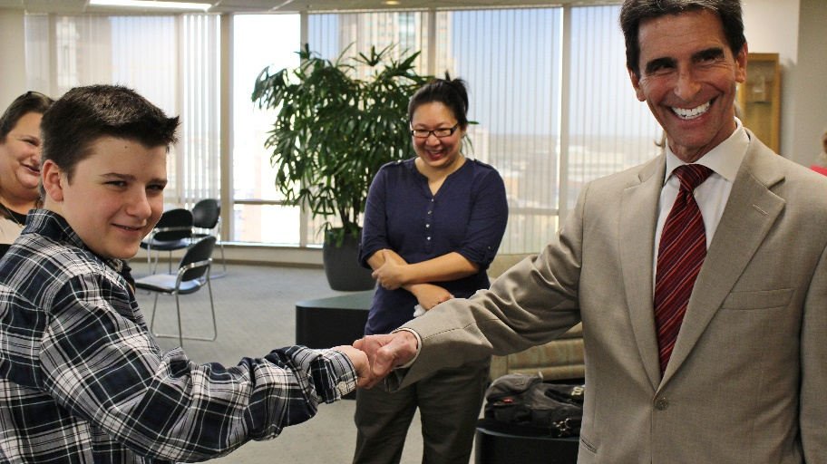
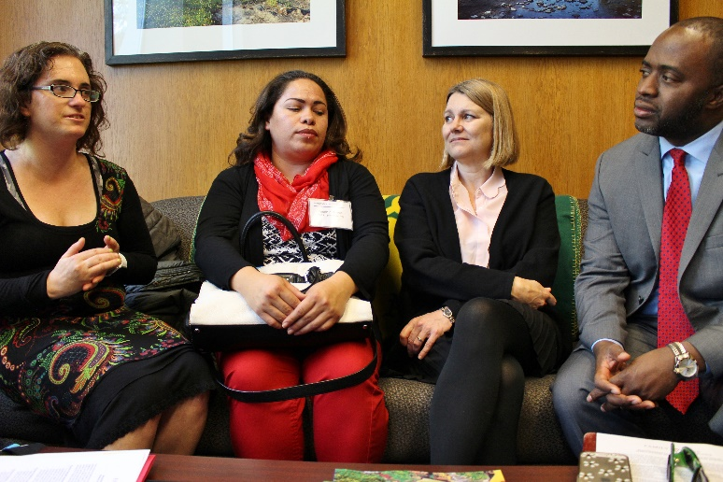
Meeting with Local and State Policymakers
Notes:
Meeting with local and state policymakers
RECENT SURVEY RESULTS: 65% Eng speaking contact with legislators
35% Spanish speakers
Graduates have met with local, state, and federal policymakers and system administrators to advocate for specific legislation and service improvement.
Project Leadership graduates visit their state legislators and / or staffers on Legislative Day following the FVCA Health Summit the last three years. (dozen or more)
Graduates are also staying informed on current issues / legislation affecting CYSHCN / disabilities and are communicating with their legislators via email / phone / social media / fax / in-person visits to express support or concern on specific issues.
2 visited governor’s office and shared parent perspective – AB187 (CCS Carve Out Extension)
SB586
Medi-Cal

Slide 15
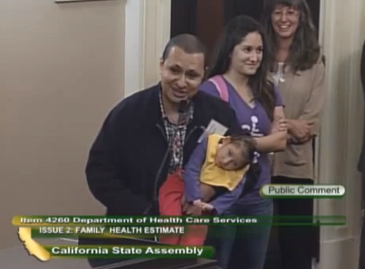
Providing public testimony
https://www.youtube.com/watch?v=JU1shpujZ6g
Notes:
Providing public testimony
Graduates provide public testimony at state assembly / senate committee hearings since graduating from Project Leadership. Many have been around the CCS Redesign / Whole Child Proposal other issues as well out-of-pocket costs for consumers, mental health services, SF housing crisis and importance of living close to services, specialists, resources for daughter and others…
Shown here: Three graduates testified at California State Assembly hearing subcommittee hearing on proposed changes to the state’s Title V CCS program (2014)

Slide 16
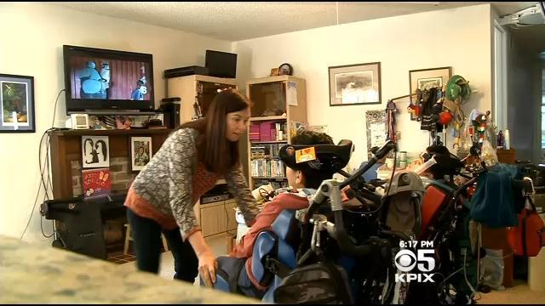
Telling Their Stories to the Media
Notes:
Telling their stories to the media
RECENT SURVEY RESULTS: 20% ENG SPEAKERS / 0% SPAN SPEAKERS
One parent was interviewed by Kaiser Health News regarding her family’s transition from Healthy Families to Medi-Cal: (A version of this article was also published in the Oakland Tribune and the San Jose Mercury News.)
The parent behind AB 662 (Public diapering facilities for youth and adult with disabilities) was featured in a local CBS newscast.
The idea for this bill originated from Alisa Rosillo, a Concord resident and mother of two teenage wheelchair-bound boys. Because her young adults require diaper changing, she is forced to limit her excursions to less than four hours or be forced to change them on the floor.
Last year, another parent contacted the media and was featured by two local SF stations regarding the closing of the special education program in which her son is enrolled.
A handful have been interviewed about CCS Redesign / Whole Child Proposal
Two had opinion articles published in the California Health Report:
When autism ages out of the school system
Why I'm fighting the state on behalf of my son
Graduate’s work with Children's Hospital Oakland Family Advisory Council was featured in a new series that her employer, the Federal Reserve Bank of San Francisco, has started called "Unreserved." It spotlights the passions and unexpected contributions of their employees.

Slide 17
Lessons Learned
On-going curriculum revision
Flexible scheduling, childcare, and stipends
Long-term mentoring and facilitated peer support
Variety of means for communication, mentoring, and support
Educating others about importance of family participation
Notes:
Curriculum Revision:
In participant evaluations of the curriculum, they have suggested more attention to cultural differences and learning styles of the group. They also requested more information about the history of the health care system and current issues, such as changes to California Children’s Services (CCS), the state’s Title V program. Project Leadership curriculum will continue to evolve based on participant input and on new developments in health care and legislation.
Other practical lessons that others interested in implementing the curriculum may want to consider:
As mentioned earlier, flexible scheduling, childcare, and stipends all proved important in recruiting and retaining participants.
The long-term mentoring and facilitated peer support among program graduates have been essential for continued motivation and engagement of graduates.
Offering a variety of means for communication, mentoring, and support helped ensure that all graduates’ needs were met. (e.g.,in-person mentoring, phone calls, email, online advocacy group)
FVCA also learned that in order to build on family partnership and encourage growth of parent opportunities, FVCA and host site agencies need to educate more agencies to help them understand the importance of including families, develop guidelines for family involvement, and remove barriers to family participation – This is an ongoing effort / process. (e.g., Fatherhood Initiative Group)

Slide 18

Budgeting & Funding
How much does the training cost?
How is it funded?
Notes:
Budget estimates: Because of the variation in ways training can be implemented, cost to implement training also greatly varies.
Will you offer Stipends? Food? Childcare? Or do you need to only cover cost of Materials? Do you have a Trainer already on staff or need to hire a new one? Do you have an adequate Training space / conference available at no cost or do you need to rent a space?
For one agency the cost for implementing 4 trainings (two simultaneous seven week series) over a one year period = $47,000. This included hiring trainer, childcare, stipends, recruitment materials / efforts, meeting space, training materials, etc. For 50 graduates
This year SFF is building the trainings into existing parent training program over an 8 month period (trainings are monthly), so cost is low. Agency can decide how much of a stipend to offer. Childcare depends on agency as well. How agency is structured largely effects budget as well.
information / guidance on how agencies might approach local foundations / funders, including template for grant proposal
Partnering opportunities e.g., First Five / Regional Center / SCDD / CCS
Who pays?
FVCA is funded for central coordinating efforts including T of T, mentoring, support, alumni activities, TA, etc
Local agencies responsible for cost of training. Go into this extensively in TofT workshop

Slide 19
Training-of-Trainers Workshop
Participants:
Gain an understanding of curriculum content
Learn best practices for recruitment & retention, facilitation of curriculum, mentoring & support, administration & reporting
Explore budgeting and funding options
Develop an action plan for training implementation
Notes:
TRAINING-OF-TRAINERS WORKSHOP COVERS BEST PRACTICES FOR ALL TOPICS COVERED TODAY:
RECRUITMENT & RETENTION, FACILITATION, MENTORING & SUPPORT, BUDGETING & FUNDING, ADMISTRATION & REPORTING, CONTENT OF CURRICULUM,
GOAL for Phase IV remains the same: continue to build strong, statewide learning community with mentoring and support that helps ensure that family members CSHCN are prepared to become advocates for health care policy and service improvements. In year 4 we aim to continue to expand around the state – all regions are welcome.
Two-day train the trainers workshop – SF (Jan 10 & 11 or Jan 18 & 19, SFCD) LA (Jan 30 and 31 Cal Endow, LA)
Training includes:
Overview and Highlights of Curriculum content
Best practices for facilitation, recruitment and implementation, mentoring and support, administration and report. Also includes budgeting and funding options.
Menu of Technical Assistance Options:
Online group for / scheduled conference calls with Trainer / Mentors facilitated by Project Leadership Manager
Problem solving with Project Leadership Manager via phone or email
Site visit and in-person consultation with PL Manager
Request for Applications:
Due Nov 14.
RFA asks applicants to send a rep to 2-day training in SF / LA. $500 offered to help offset travel costs. RFA asks to describe organization, reason for wanting to participate, and existing or planned resources for implementing trainings. Also asks to demonstrate commitment to implementing within timeframe.
Next week will hold conference call to answer any questions. Nov 2 12:00-1:00 (see RFA)
DEC 2 ANNOUNCE ACCEPTED APPLICANTS

Slide 20
Training-of-Trainers Workshop
DATE | ACTIVITY | NOTES
Wed, July 19, 2017 | RFA Disseminated
Thurs, Aug 3, 2017 12:00 am-1:00 pm | Project Leadership Informational Webinar | This webinar will be recorded and can be accessed at: http://www.familyvoicesofca.org/webinar-archive/
Thurs, Aug 10, 2017 Wed, Aug 23, 2017 11:00 am-12:00 pm | 2 Conference Calls | Ask questions and learn more about the project. Call in Number: 267-930-4000 Pass Code: 192-772-881
Friday, Sept 1, 2017 | Applications due
Mon, Sept 11, 2017 | Selection of programs | Project Leadership Manager contacts selected applicants.
Wed & Thurs, Oct 11 & 12, 2017 9:00 am-5:00 pm | Northern California Training-of-Trainers Workshop | Location: Support for Families: 1663 Mission, 7th floor San Francisco 94103
Wed & Thurs, Nov 29 & 30, 2017 9:00 am-5:00 pm | Southern California Training-of-Trainers Workshop | Location: California Endowment Conference Center 1000 N. Alameda Street Los Angeles 90012
October 2018 | Deadline for selected organizations to complete the parent trainings in their region. | Participants will receive information about reporting requirements at the Training-of-Trainers Workshop.
$500 stipend offered to offset costs of attending
Notes:
GOAL for Year 3 remains the same: continue to build strong, statewide learning community with mentoring and support that helps ensure that family members CSHCN are prepared to become advocates for health care policy and service improvements. In year 3 we aim to continue to expand around the state – targeting more rural areas and Los Angeles, but all regions are welcome.
Two-day train the trainers workshop – Please note the grant cycle began at the end of April and we are currently developing curriculum and plans for T the T!! Training to include:
Curriculum content
Best practices for recruitment and implementation
Budget estimates: Because of the variation in ways training can be implemented, cost to implement training also greatly varies.
For one agency the cost for implementing 4 trainings (two simultaneous seven week series) over a one year period = $47,000. This included hiring trainer, childcare, stipends, recruitment materials / efforts, meeting space, training materials, etc.
This year SFF is building the trainings into existing parent training program over an 8 month period (trainings are monthly), so cost is low. Agency can decide how much of a stipend to offer. Childcare depends on agency as well. How agency is structured largely effects budget as well.
information / guidance on how agencies might approach local foundations / funders, including template for grant proposal
Participants will develop Action Plan implementing all or parts of PL model: (e.g., Participants might set a timeline for acquiring funding and / or integrating trainings into an existing training (i.e., SFF example above). , scheduling training, recruiting plan / timeline, plan to use portions of curriculum in workshops / trainings, agree to work with FVCA / me to collaborate on identifying advocacy opportunities.
Request for Applications: (Again in process)
Original grant timeline projected T the T April 2016. We are now thinking Fall 2015. RFA to go out this summer through FRCNCA. RFA will ask FRC applicants to send a rep to 2-day training in SF. $500 offered to help offset travel costs. RFA will ask participants to demonstrate commitment to the Project Leadership (e.g., potential funders / way to integrate training into existing program, potential recruitment contacts, potential trainer, etc. STICKING POINT REGARDING HOUSING IN FRCS / POTENTIAL FOR OTHER AGENCIES TO PARTNER WITH FRCS – TRAININGS IDEALLY HELD AT FRCS WHERE FAMILIES ARE COMFORTABLE, SUPPORT SERVICES IN PLACE.

Slide 21
Alumni Testimonies
Project Leadership helped build my confidence to advocate for my child and other children with health care needs. It also gave me the strength and confidence to continue pushing to get services and make sure programs continue happening for children.
I really believe this experience is life-changing for the unexpected role I’ve found myself in of a mother of a special needs daughter. …I am proud to be a Project Leadership alum and am excited to see what we all do with our empowered voices.
Project Leadership Training has allowed me to further build my confidence as an advocate. I have progressively taken on the role as an advocate for her special health care needs but always felt ‘stuck’ when it came to further advancing. This training has given me the tools, information, and necessary leadership skills to further my advocacy voice for my daughter and other families.
I feel so empowered and inspired to take my advocacy work to the next level. Project Leadership graciously provided me with the tools and strategies to tailor my story to a specific issue and how to be an effective communicator using a balance of emotion and objectivity.
Notes:
A recent follow-up survey of 75 Project Leadership graduates who completed the training within the last four years revealed that 96% of respondents “frequently” or “occasionally” used the skills obtained in Project Leadership training, including effective communication and partnership with health care providers, when advocating for their own child; furthermore, 89% of respondents “frequently” or “occasionally” used the skills obtained in Project Leadership training in their work with committees, boards, decision makers, media or in other leadership roles. Approximately 95 – 99% of respondents felt “confident” or “somewhat confident” after completing the training that they could participate in policy change discussions with decision-makers; that they could use advocacy tools specific to various issues/advocacy situations, that they could tell their child's story in a way that informs people with decision-making power about why they need to change policies and systems, and that they felt that the Project Leadership training had prepared them to become an advocate. Survey results could also be summarized in an accompanying figure, with less narrative.
PARENTS LOVE THIS TRAINING: 80 – 98 PERCENT LIKELY OR VERY LIKELY TO RECOMMEND
PARENTS, TRAINERS, AGENCIES OPPORTUNITY TO BE PART OF A GROWING STATEWIDE NETWORK OF FAMILY LEADERS AND TRAINERS.
SUPPORTED AND INFORMED.

Slide 22
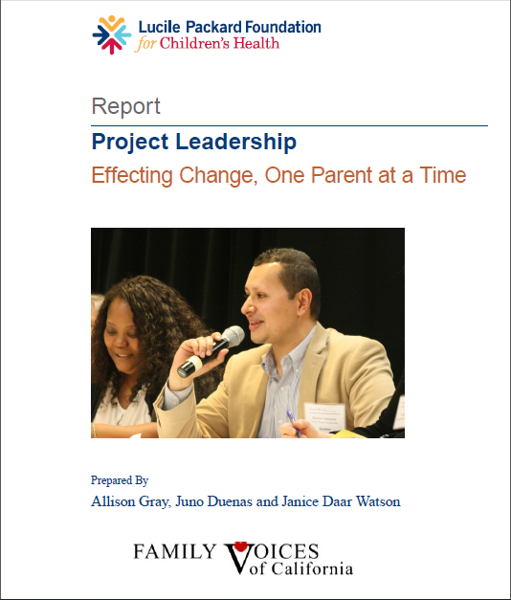
For More Information…
http://lpfch-cshcn.org/publications/research-reports/project-leadership-effecting-change-one-parent-at-a-time/

Slide 23
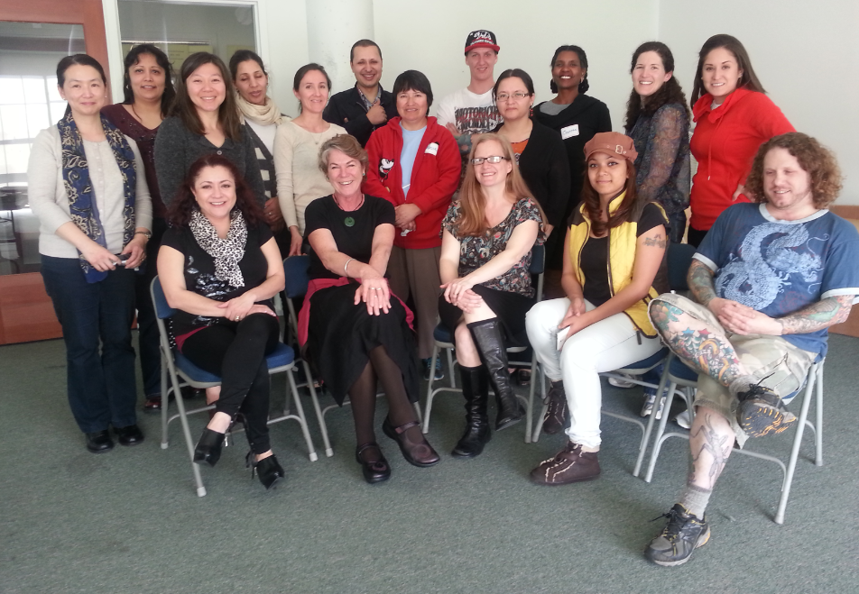
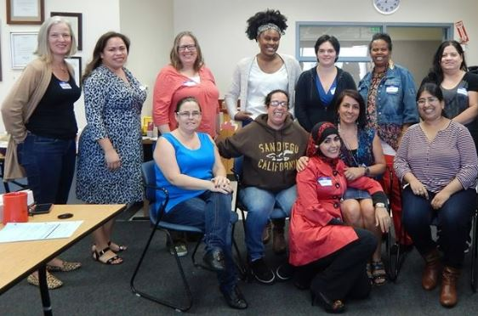
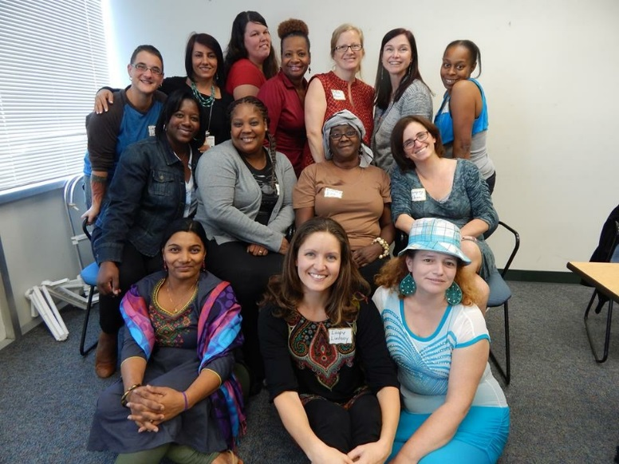
Never doubt that a small group of thoughtful, committed citizens can change the world. Indeed, it is the only thing that ever has.
- Margaret Mead
Public Policy Advocacy:: A Grassroots Guide, The Statewide Parent Advocacy Network, span@spannj.org
Notes:
I chose to include this quote by cultural anthropologist Margaret Mead because I think it does a really good job of encompassing the overall goal of Project Leadership.
A few of the graduating groups appear in the photos – one of the SF, two of the Alameda County groups.

Slide 24





Thank You!
Allison Gray www.familyvoicesofca.org
415-282-7494 ext 136 www.facebook.com/familyvoicesofca.org
agray@familyvoicesofca.org @familyvoicesca
familyvoicesca

