Slide 1
After Brain Surgery: Educational Advocacy
Notes:
Audrey Vernick, COPAA/SEAT Trained Advocate,
Director of Educational Advocacy and Training for
the Brain Recovery Project: Pediatric Epilepsy Surgery Foundation
My name is Audrey Vernick and my son, Bennett, had a right hemispherectomy at age 2. He is now 14 and enrolled in an NPS placement, after 5 years of inclusion in our public school district. He had a stroke in utero and suffered chronic, unrelenting infantile spasms on 6 different medications for 30 months before his hemi surgery. He also had a shunt placed in 2010 to resolve subsequent hydrocephalus. In 2016 we launched our advocacy division in an effort to support families navigating the IEP process for their children’s after brain surgery for epilepsy.
Educational Advocacy After Brain Surgery Part 2
June 6, 2018 12:00 PM PDT
Register here: https://register.gotowebinar.com/register/6771045882500817409
These presentations are intended to provide information to help parents and professionals understand the impact on a child’s brain after injury or surgery and how to advocate for special education programs and services for those children and youth. Training topics will include: function of each brain lobe/region, impact of brain injury on functional outcomes, understanding the Individual Education Program (IEP) process; basic special education rights; referral procedures for special education assessment; parent rights in the IEP process; and effective advocacy techniques.
Webinar Presenter: Audrey Vernick, Director of Educational Advocacy and Training at The Brain Recovery Project: Pediatric Epilepsy Surgery Foundation.

Slide 2
Incredibly Excessive
Paperwork
You’re Not Crazy
Don’t Get Overwhelmed
Chunk Your Learning
This Stuff Is Difficult
IEPS Are Rarely Fixed In The Actual Meeting
Keep An Organized File
If It Isn’t In Writing, It Didn’t Happen

Slide 3
KNOWLEDGE IS POWER
If you’re going to advocate for something for your child, you must understand it.

Slide 4
KNOW
The Brain
The Child’s Surgery, Its Effects
The Child’s Disabilities
The IEP Process
Interventions/Teaching Strategies

Slide 5
Letter from the neurosurgeon
Describe etiology
Describe procedure(s)
List effects of the disconnection/removal of specific lobes of the brain (i.e. temporal / auditory impairment, occipital / vision impairment, frontal / motor impairment),
List suspected effects (Other Health Impairments) such as fatigue, hydrocephalus, ADHD, autism, SLD, ID, behavior, etc.)

Slide 6
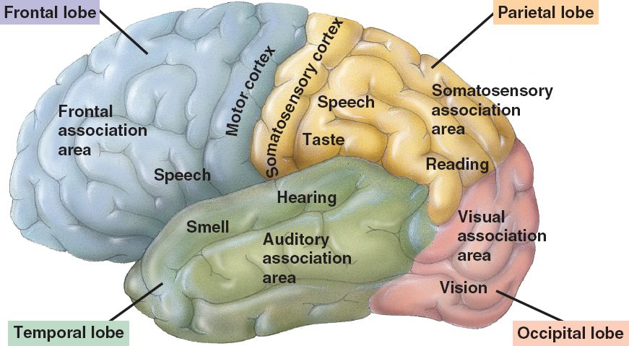
The Cortex
The familiar part of the brain with multiple folds and lobes.
“Cortical”

Slide 7
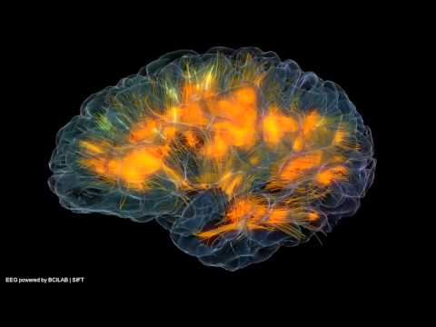

Slide 8
Individualized Education Program (IEP)
Free and Appropriate Public Education (FAPE)
Least Restrictive Environment (LRE)
Appropriate Evaluation
Parent and Teacher Participation
Procedural Safeguards
THE IDEA:
Individuals with Disabilities Education Act

Slide 9
“Over 20 years of research has demonstrated that the education of children with disabilities can be made more effective by (A) having high expectations for such children and ensuring their access to the general education curriculum to the maximum extent possible”

Slide 10
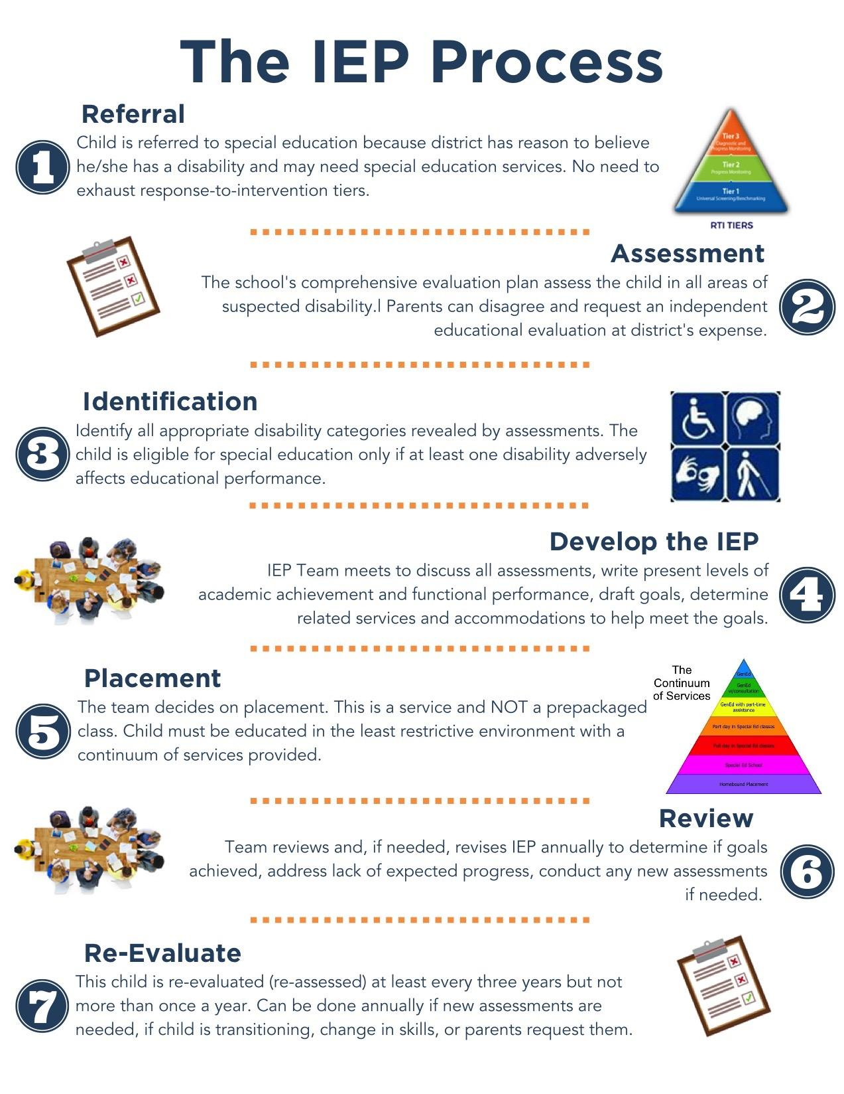

Slide 11
STEP 1 - REFERRAL

Slide 13
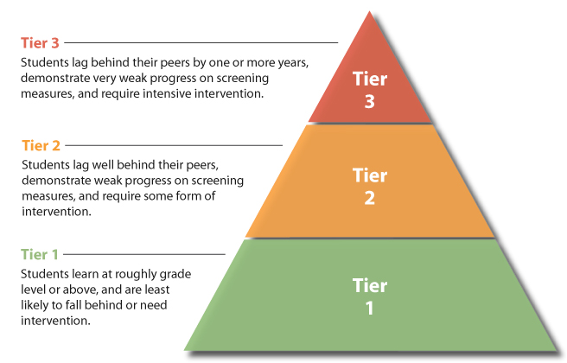

Slide 14
STEP 2 - ASSESSMENT

Slide 15
#1 RULE OF IEPS
WHAT MOMMY WANTS DOESN’T MATTER

Slide 17
“CHILD FIND”
School must locate, identify, and evaluate every child in the district that has a disability.
Locate
Identify
Evaluate

Slide 18
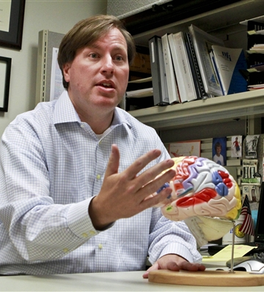
Evaluations are the most important part of the IEP
You need an expert to discuss strengths, weakness, interventions, etc.
Attorney will ask “what do the evaluations say”
This is where you spend your money.

Slide 19
That’s ‘medical’, we don’t need to do that...
“Can I ask for very specific kinds of assessments — such as a neurological examination or a non-oral assessment? What if the district does not have appropriately trained personnel to do the testing?
Yes, you can ask for specific assessments. The district has the responsibility to assess in all areas related to the suspected disability. If there is no district person competent to carry out certain kinds of evaluation, the district may contract out for the service or may use the results of any available independent assessment. In certain cases, the diagnostic services of a physician or other health professional may be required if the child’s suspected disability is medically related — and as a result the child needs special education. [34 C.F.R. Secs. 300.34(a), (c)(5).]”*
*From the SPECIAL EDUCATION RIGHTS AND RESPONSIBILITIES handbook, Community Alliance for Special Education (CASE) and Protection and Advocacy, Inc. (PAI) Copyright © 1992 by CASE and PAI, Ninth Edition, November 2005

Slide 20
What assessments are needed after brain surgery?

Slide 21
Psychoeducational (includes Educational / Academic Performance)

Slide 22
Neuropsychological

Slide 23
Reading (diagnostic reading assessment)
A comprehensive assessment should include measures of the 'essential components of reading’: phonemic awareness; phonics; vocabulary; reading fluency, including oral reading skills; and reading comprehension.

Slide 24
CIRCUITS - pathways
“The act of reading itself is anything but natural. Human brains weren’t designed to read: There is no “reading center” of the brain, and there are no “reading genes.” Instead, in order to read, each brain must fashion new circuits between parts originally designed to do other things, like retrieving the names for objects. These new circuits must not only combine many processes from different areas of the brain to form a specialized circuit just for reading -- in order to become a fluent reader, the circuit also needs to run lightning-fast, nearly automatic.”
Understanding Dyslexia and the Reading Brain in Kids. Holly Korbey. KQED MINDSHIFT. Oct. 1, 2015. https://www.kqed.org/mindshift/41845/understanding-dyslexia-and-the-reading-brain-in-kids?utm_source=facebook.com&utm_medium=social&utm_campaign=npr&utm_term=nprnews&utm_content=202503

Slide 26
VISION
Acuity
How sharp is the child’s vision?
School assessor
Optometrist (must have this evalaution privately)
Visual Field
Perimetry test
Neuro-ophthalmologist
Developmental Optometrist
Functional Vision
How does the child use his/her vision?
Teacher of the Visually Impaired
Orientation and Mobility Specialist

Slide 27
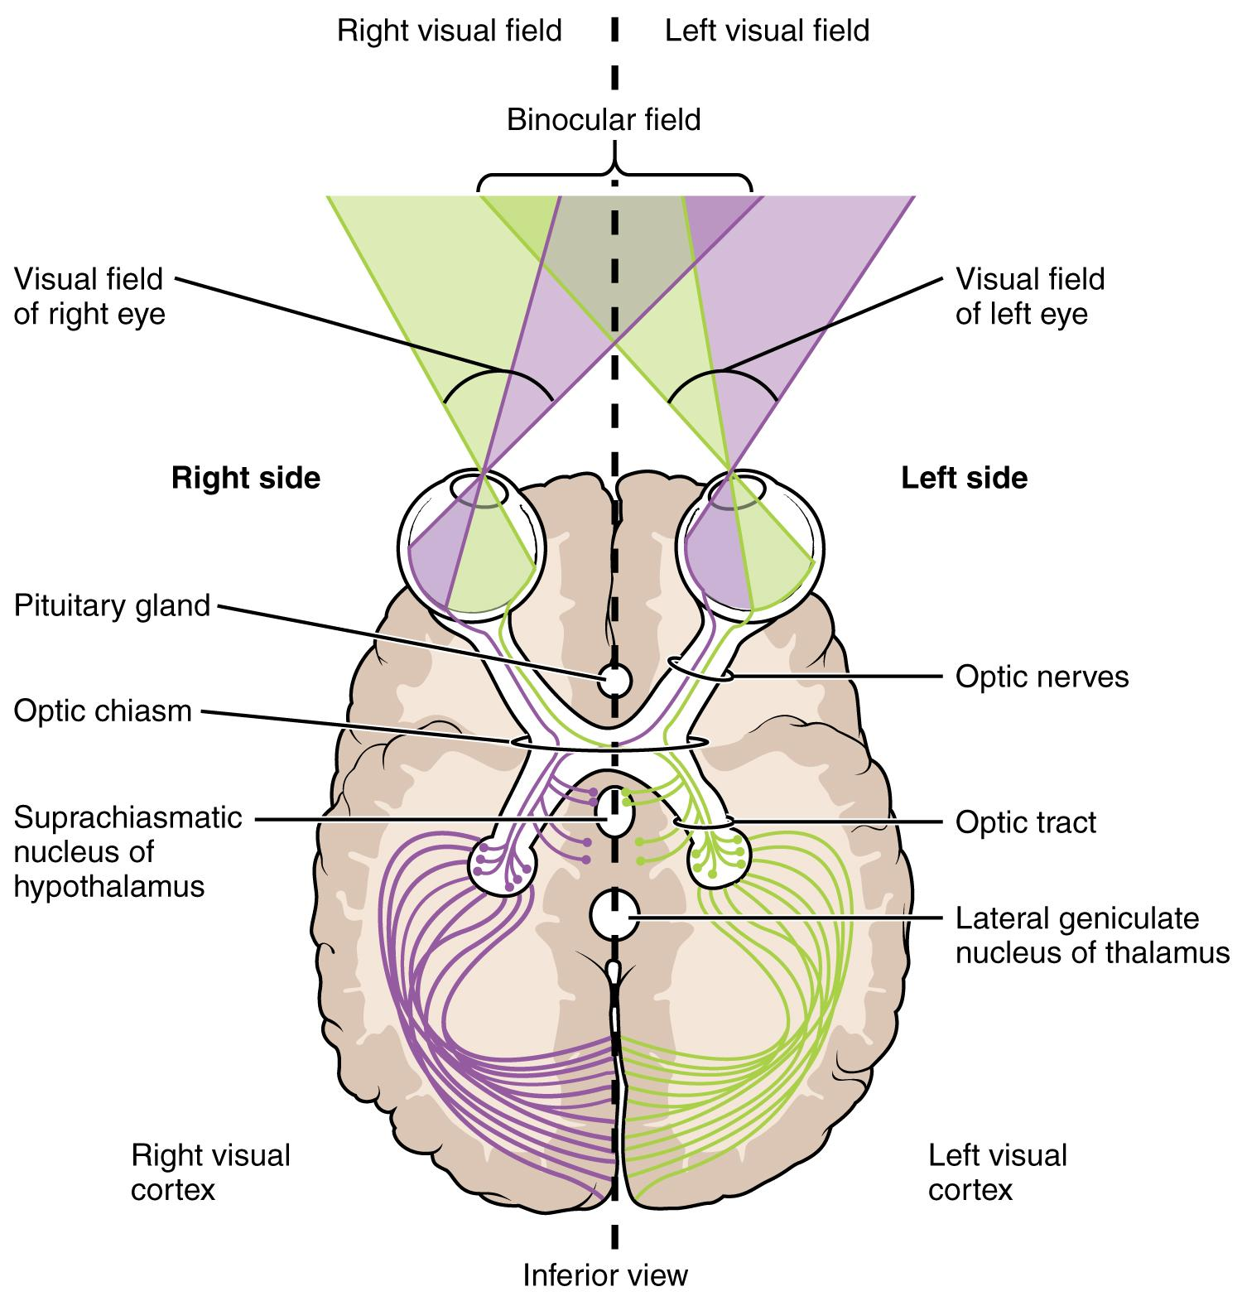

Slide 28
VISUAL PROCESSING
Visual Processing
Neuropsychologist
Neuro-ophthalmologist
Developmental Optometrist

Slide 29
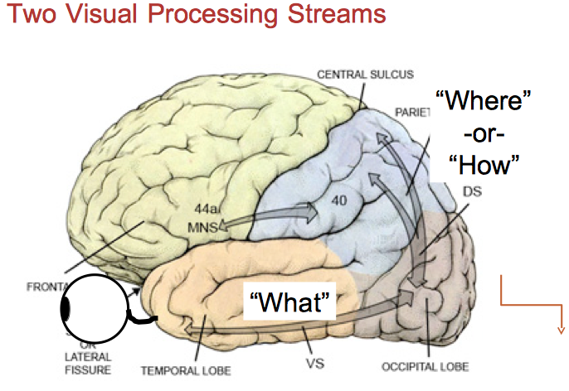

Slide 32
ORIENTATION AND MOBILITY
Static, Dynamic, Familiar, Unfamiliar Environments

Slide 33
HEARING & LISTENING
Auditory Processing
What the brain hears
Acuity
Audiometer - hearing sensitivity

Slide 34
Auditory Processing
Dichotic listening
Sound localization
Sound lateralization
Acoustic scene
Testing - at least age 7, normal IQ
How the brain processes what the ears hear

Slide 35
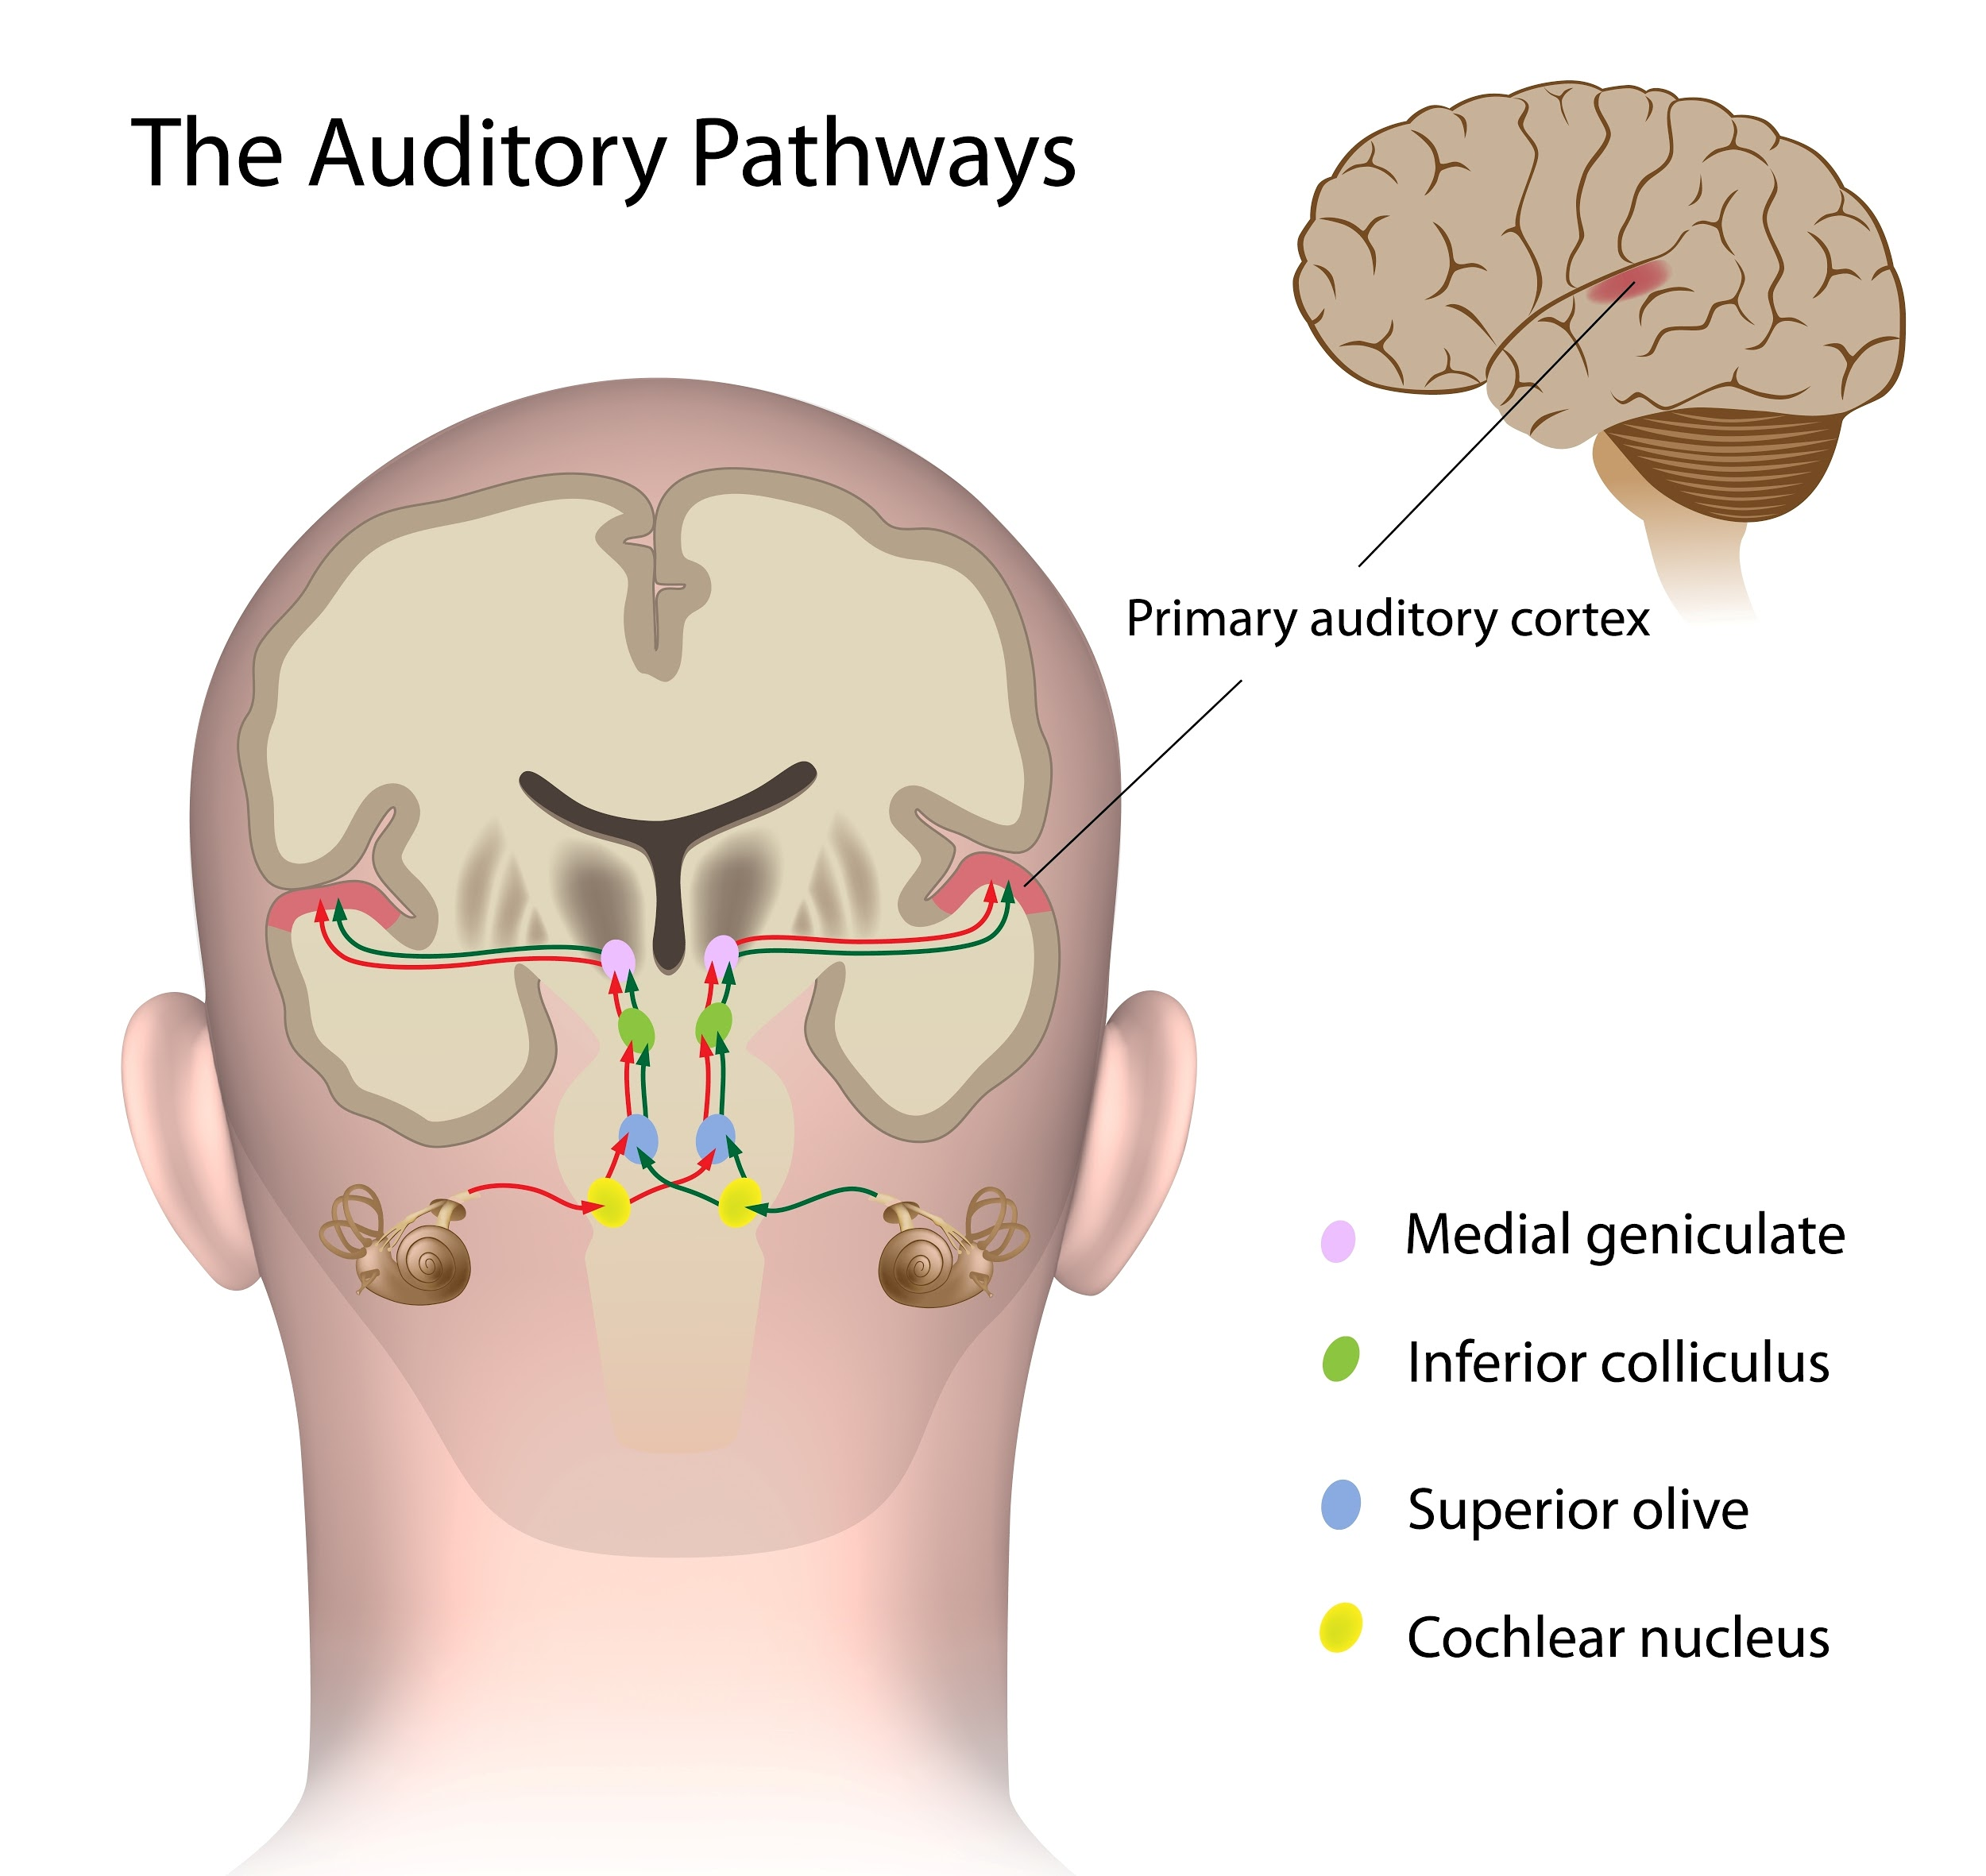

Slide 36
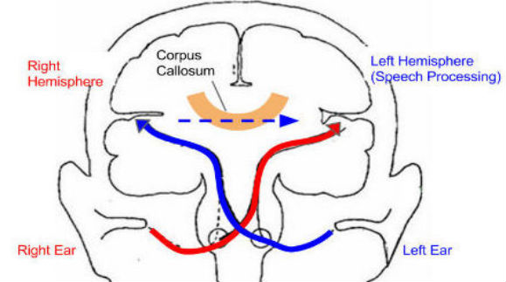

Slide 37
GROSS MOTOR SKILLS
Mobility and functional abilities
Balance,
Coordination,
Ambulation
Core strength and postural control,
Transfers

Slide 38
ADAPTED PE
Rhythm and timing,
Gross motor play skills

Slide 39
OCCUPATIONAL THERAPY
Sensory processing, Proprioception, Self-regulation
Gross motor skills,
Balance,
Vestibular,
Coordination
Functional Fine &
visual-motor skills

Slide 40
SPEECH & LANGUAGE
speech, language, cognitive-communication
nonverbal comprehension, social/pragmatic skills
phonology, syntax, and morphology,
language meaning, language in context

Slide 41
Augmentative Assistive Communication

Slide 42
Assistive Technology

Slide 43
Functional Behavior

Slide 44
Mental Health

Slide 45
Health / Medical

Slide 46
HOW TO ASK FOR AN INDEPENDENT EDUCATIONAL EVALUATION

Slide 47
Remember an evaluation = many different assessments
IF YOU DISAGREE WITH EVEN ONE ASSESSMENT, YOU’RE ENTITLED TO AN “INDEPENDENT EDUCATIONAL EVALUATION “

Slide 49
QUALIFICATIONS OF ASSESSOR
Check requirements in state regulations
Check assessment company requirements
Check ethics rules of professional organization

Slide 50
DIAGNOSTICS
What tests did they use?
Are they appropriate for a child with multiple disabilities?

Slide 51
RECOMMENDATIONS
The school’s assessments may not include recommendations, this is why it’s imperative that you hire your own assessor, so robust recommendations are given.

Slide 52
PROBLEMS WITH EVALUATIONS
Assessor unfamiliar with the disability
Evaluation is not comprehensive
Not enough assessments
Assessments incomplete (e.g. child did not finish)
Wrong facts
Wrong conclusions

Slide 53
Must independent evaluations be considered?
“Various professional reports that you may have received on your child from other sources — such as a regional center or doctors — would help the assessment process. For example, speech and language, occupational and physical therapy, neurological or ophthalmological reports; current teachers’ observations (from preschool or a different district); respite, recreational or camp personnel observations; and special medical reports are often useful. School districts generally ask you to share the other professional reports with them to assist in determining your child’s needs. In fact, any independent evaluation provided to the school district by the parent must be considered in any decision related to the student’s programming and services. [34 C.F.R. Sec. 300.305(a)(1)(i); Cal. Ed. Code Sec. 56329(c).]”**From the SPECIAL EDUCATION RIGHTS AND RESPONSIBILITIES handbook, Community Alliance for Special Education (CASE) and Protection and Advocacy, Inc. (PAI) Copyright © 1992 by CASE and PAI, Ninth Edition, November 2005

Slide 54
Educational Advocacy After Brain Surgery Part 2
June 6, 2018 12:00 PM PDT
Register here: https://register.gotowebinar.com/register/6771045882500817409

Slide 55
“KISS”
KEEP IT SIMPLE STUPID
A long list of complaints that you have against the school won’t be heard. What are the top few things that you want?

Slide 56
Thank You!
Audrey Vernick
Director of Educational
Advocacy and Training
avernick@brainrecoveryproject.org
www.brainrecoveryporject.org

Slide 57
Invisible disabilities have that extra burden of "proof" needed to pass that litmus test to demonstrate "need." (She looks so "normal"). This is where data, documentation and specific communication to advocate for our children are so needed.
I'll never forget my daughter's high school advisor say to me (after brain surgery): "Is she fixed now?"
I had a (former!) doctor ask me if I was "willing to hire an attorney" so my child could attend school with a 1:1 nurse. Turns out insurance would cover with no issue based on her million diagnoses. KNOW your state and know the programs available.
Medical practitioners are taught to use logic and if trained at a good school, empathy. These tools are not that helpful in the IEP setting.
It would be helpful to have info graphics to help us explain our kids conditions, especially when there are multiple diagnoses or one thing is sequelae to another, but not a primary diagnosis.
Have a neuropsychological evaluation done. That report was our tool for communicating to the school what our kiddo's IEP should entail. We learned how to teach him based on how how his brain functions.

