Slide 1
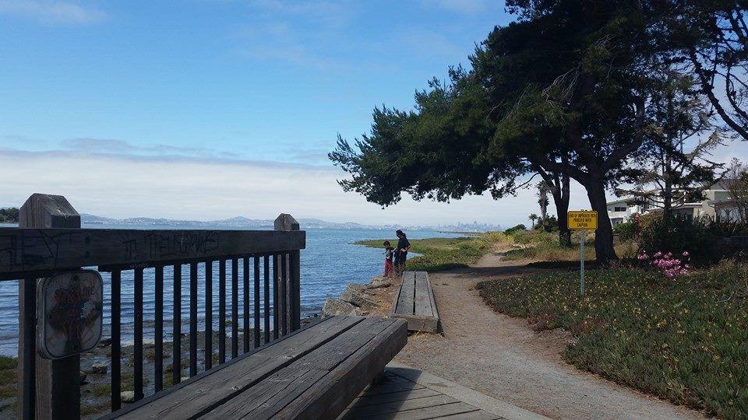
Resilience, Coffee, and Community: How Parents Advocate for Children with Special Needs
Family Voices of California Parent Advocate Webinar
June 17, 2015
Sarah Taylor, MSW, PhD
Associate Professor, CSU East Bay Dept of Social Work

Slide 2
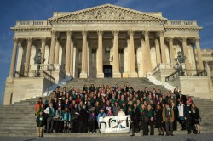
Overview
Introductions
Acknowledgments
Personal & Professional Background
Personal Experience with Advocacy
Professional Experience with Advocacy
Research on Advocacy Experiences of 300+ parents
Image from: http://www.fragilex.org/2014/advocacy/advocacy-day-posts/nfxfad14/national-fragile-x-advocacy-day-2014-not-even-the-winter-storm-could-stop-us/

Slide 3
Acknowledgments
CSUEB Dept of Social Work
Survey & Interview Participants
Family Voices of CA
Allison Gray
Anne Hall
Pip Marks
Co-Researcher Amy Conley Wright
Zachary Drake & Quinn Drake Taylor
Incredible network of support/hive mind
East Bay Parents of Kids with Special Needs: https://sites.google.com/site/ebparentsofkidswspecialneeds/
Fragile X Foundation Facebook Group: https://www.facebook.com/groups/FXFiles/

Slide 4
I hope in your study you will discover that mothers of special kids are amazing and put themselves in front of any firing squad whether it be untrained schools, lame doctors, or penny pinching insurance companies to fight for their children.
I never thought I would be capable of being such a strong advocate for anyone. Before having a child with special needs I was more soft-spoken and tended to go along with what others thought was best. I realized (very quickly) that this would not provide the best care or outcome for my child. In a world where we are supposed to trust the experts, I learned to trust myself. I am the expert when it comes to MY child.
In an IEP meeting - my 3 year old with Down Syndrome was going to be placed in a classroom with Severely Handicapped Students because of lack of space in a different Special Needs classroom. My son is not Severely Handicapped & was not a good fit in that classroom - there would have been no motivation for him to grow. It was the answer to the problem in our school district to just get him placed. We would not sign the IEP. Called an additional meeting, took an attorney & a Down Syndrome Advocate. Ended up with the best classroom placement ever. I have learned to not take NO for an answer !

Slide 5
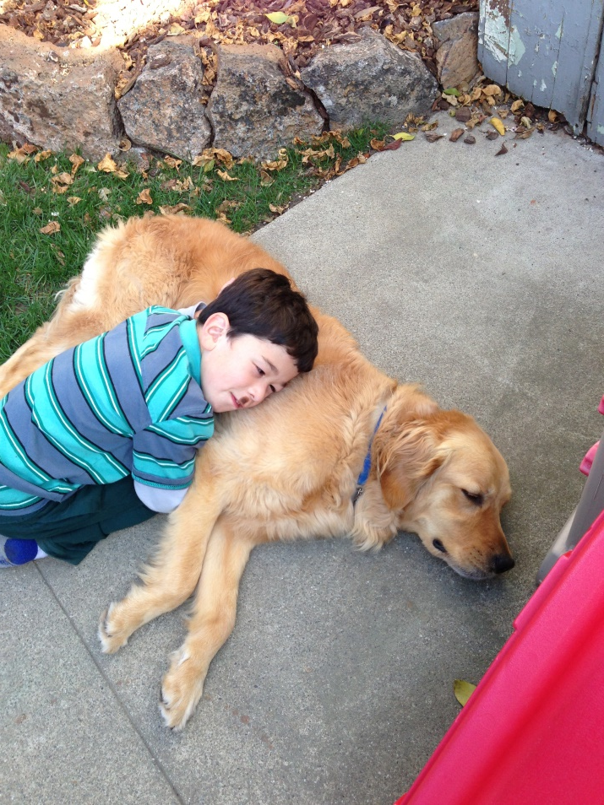
Background
Origin of idea for this research
Personal and professional journey
Collaboration with Amy Conley Wright, MSW, PhD, Senior Lecturer, University of Wollongong, Sydney, Australia

Slide 6
Our SuperKid – Quinn, age 8

Slide 7
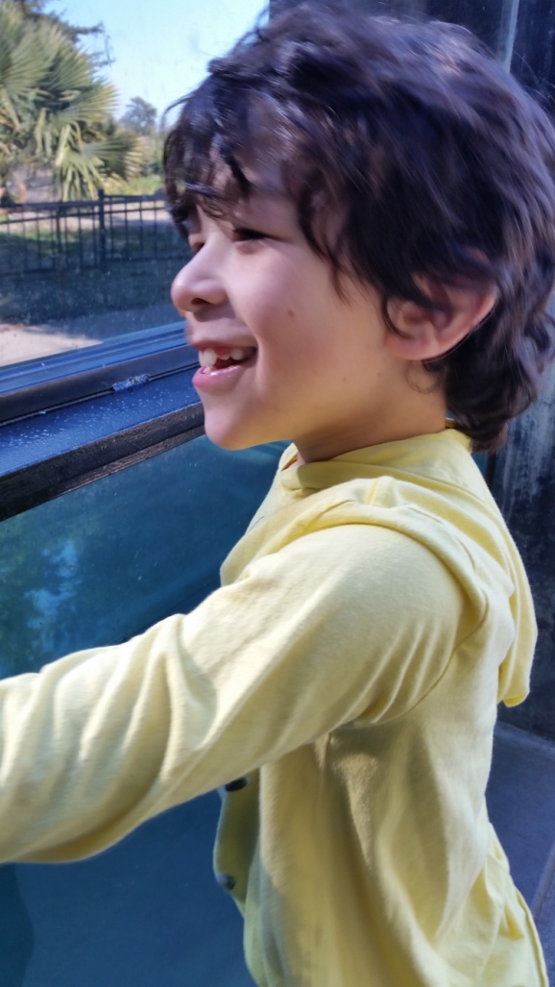
Most important things to know about Quinn
Incredible joie de vivre
Excellent sense of humor
Loves animals
Curious nature
Great helper at home and in school
Many interests: sports, music, cooking, play doh, appliances of all kinds, public transportation, water, technology, walks around the neighborhood, Ernie & Bert, Peppa Pig, and Daniel Tiger

Slide 8
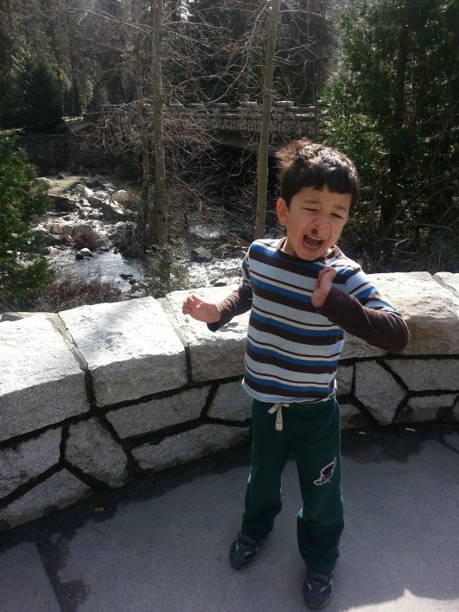
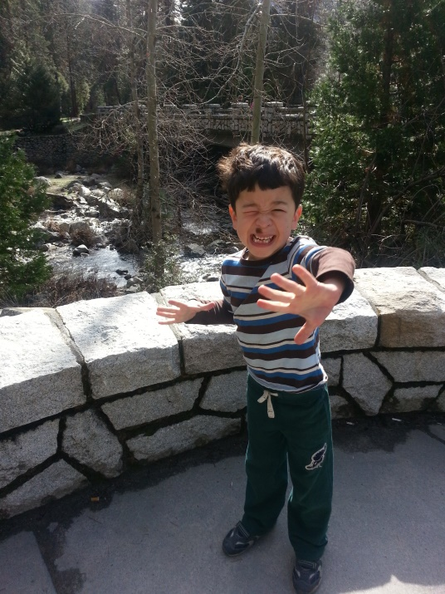
Challenges
Social
Behavioral
Sensory
Developmental Delay
Communication
Daily living skills
Community Safety

Slide 9
Advocacy: Speaking up, speaking out
Case advocacy:
On behalf of an individual or group
Cause advocacy: Related to a social issue or category of people
Slide by Dr. Amy Conley Wright
Notes:
A basic definition of advocacy relates to the etymology of the word. Advocacy derives from the Latin “advocare,” meaning “to call,” and is related to the word “vocem,” meaning “voice” (Oxford English Dictionary, 2011). Advocacy, then, can be understood as using voice to speak up and speak out.

Slide 10
Core Case Advocacy Strategies
Self care
Knowledge
Networking
Polite Persistence & Patience
Vigilance
Expertise & Authority

Slide 11
Self care – Effective advocacy begins with a well-rested advocate
First priority – Always
Especially right after a diagnosis or major challenge
Respite
Support System
Therapy/Support Groups
Work-life balance
Privacy
Setting parenting priorities
Parent first, fun first
Culture
Sense of humor

Slide 12
Knowledge
Vocabulary
Person-first language
ID, DD, MR
Therapeutic/diagnostic language
Example – using the language to make respite request
Research
Legal Rights
Disability Research, Education, and Defense Fund: http://dredf.org/
Guide to the Lanterman Act: http://www.dds.ca.gov/ConsumerCorner/LantermanActGuide.cfm
Resources
East Bay Regional Center: http://www.rceb.org/
Golden Gate Regional Center: http://www.ggrc.org/
Support for Families of Children with Disabilities: http://www.supportforfamilies.org/

Slide 13
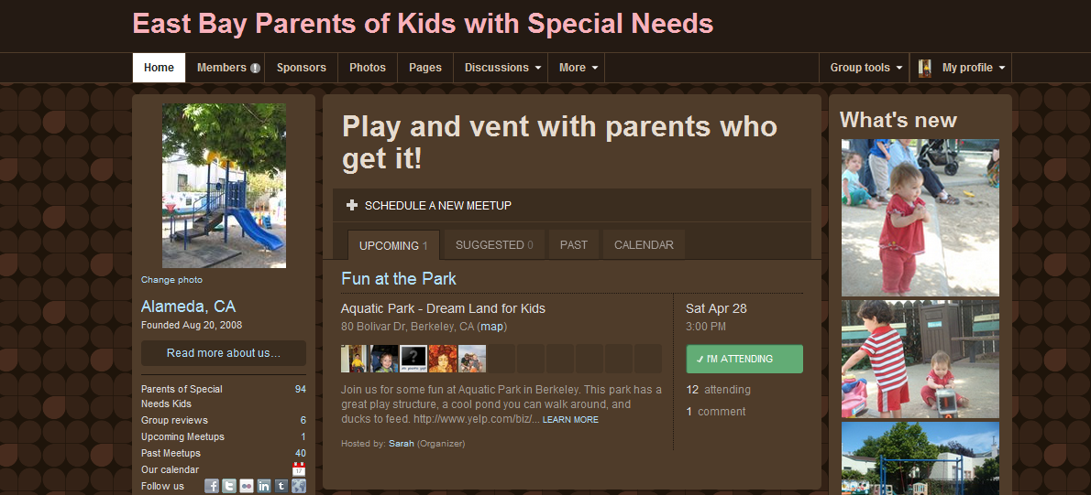
Networking
Online: blogs, social networks
Offline: SELPA, events, conferences, social gatherings
Around specific issues: moving school site and afterschool care examples

Slide 14
Polite Persistence & Patience
Phone/email often…but not too often
RCEB evaluation example
Follow your instincts!
Diagnosis example
Be prepared to repeat yourself, fill out forms, and queue up as often as needed

Slide 15
Expertise, Authority, Teamwork, & Compassion – Working with a Team of Professionals
RCEB Social Worker
Medical Insurance Staff
OT
Fine motor
Feeding
PT
SLP
School Psychologist
Audiologist
Pediatric Opthamalogist
Dentist
RCEB Dental Coordinator
Hospital-based general anesthesia for fillings
Doctors
General Pediatrician
Developmental Pediatrician
Neurologist
Geneticist
Psychiatrist
ENT
Special ed teacher, aides, and administrators
Respite workers and babysitters
Afterschool program director and staff
Early intervention program/infant stimulation
Service dog trainer

Slide 16
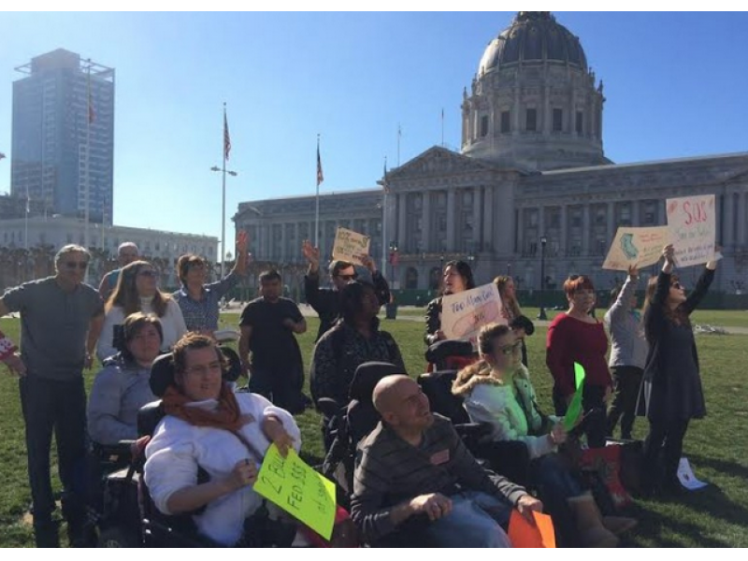
Cause Advocacy/Macro practice social work
Macro social work practice focuses on changing larger systems, such as communities and organizations. It encompasses a broad spectrum of practice, including planning, program development, community organizing, policy analysis, legislative advocacy, program evaluation, task-oriented group work, community education, and human services management.
From: http://www.bu.edu/ssw/academic/msw/curriculum/macro/index.shtml
January 24, 2015: Protesters rally to restore $500 million to DD Budget (cut in 2008). Photo from: http://patch.com/california/newark/developmental-disabilities-advocates-call-500-million-increased-state-funding-0

Slide 17
Cause Advocacy Activities
Still developing in this area. Challenges:
Time
Long wait to see results
Work so far:
Non-profit board service
New Ala Costa Alameda site – collaboration with parents and staff
MSW curriculum infusion and new elective (but it’s been dropped)
Photovoice project with three MSW students and a group of adults with I/DD at the Arc of Alameda. Works were exhibited at CSUEB with artists present. Presentation delivered at a professional conference in Boston.
Letter writing and trips to Sacramento (not as much as I’d like)
Research

Slide 18
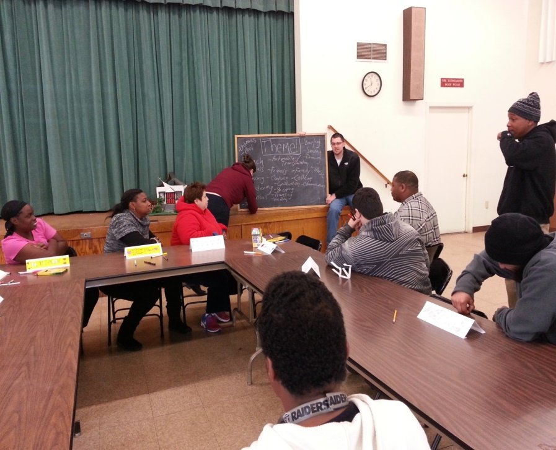
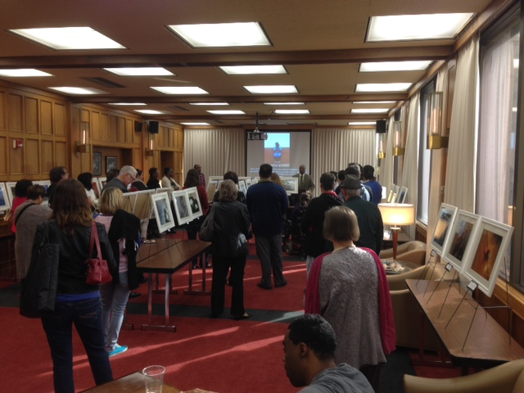
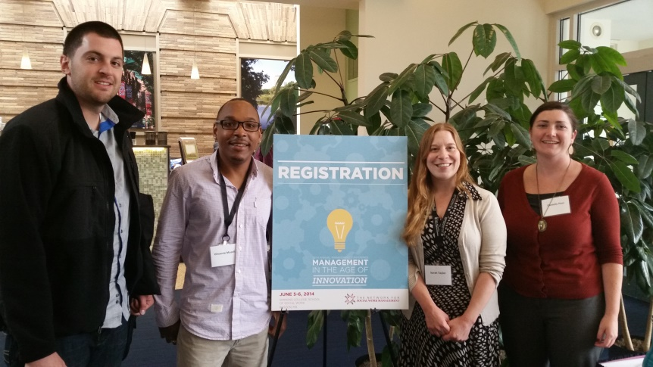
Arc Photovoice

Slide 19
This reminds me of my step-father. His name is Sonny. I was his only one only son. He brought me a dog when I was younger and blind. I have it in my heart.
– Don Juan Pierson
Notes:
Print

Slide 20
Q&A Break

Slide 21
Current Research Focus
Study of Advocacy in Parents of Children with Special Needs

Slide 22
Social work research: Person-in-environment perspective, practical applications
The focus of social work research is often the interaction between the person and environment
Social work seeks to augment ability to solve problems, realize potential, and enhance lives, while removing obstacles to well-being
Differentiates social work from related fields like psychology (more person centered) and sociology (more structurally oriented)
The purpose of research is to inform policy and practice
Social work interventions are direct (individual/family) and indirect (community/policy)
Guiding framework is social justice, which motivates social change efforts
Slide by Dr. Amy Conley Wright

Slide 23
The Bad Stuff: Selected Examples Caveat: Likelihood of experiencing these things depends on, well, everything
Relationship stress (Hartley et al,. 2010)
But maybe not as bad as you think (Divorce among parents of children with autism: Dispelling urban legends, 2013)
Higher rates of depression (Singer, 2006)
Financial difficulties (Lavelle et al., 2014)
Parenting stress (Cousino & Hazen, 2013)
Physical health problems (Seltzer et al., 2011)
Shorter telomeres (Litzelman et al., 2014)
Image from: http://www.psychologytoday.com/blog/fulfillment-any-age/201003/long-term-happiness-and-longevity-is-it-all-in-the-telomeres

Slide 24
Our goals
To learn about and share some of the good stuff.
To understand how parents develop as effective advocates over the lifespan.
To document the work that parents do to advocate for their children.
To learn more about how parents do it. What skills, knowledge, and supports do they need to be effective advocates?
To explore the relationships between coping, advocacy, and resilience.
To inform social work practice and related fields about how to support parents of kids with special needs.
To support, build, and evaluate programs that help parents make a difference at individual, organizational, community, and policy levels.

Slide 25
Resilience
…good outcomes in spite of serious threats to adaptation or development. Research on resilience aims to understand the processes that account for these good outcomes. (Masten, 2001, p. 228)
The great surprise of resilience research is the ordinariness of the phenomena. Resilience appears to be a common phenomenon that results in most cases from the operation of basic human adaptational systems. If those systems are protected and in good working order, development is robust even in the face of severe adversity…(Masten, 2001, p. 227)

Slide 26
Building a Theoretical Model of Advocacy
Coping
Resilience
Strengths
Characteristics
Resources
Support
Activities & Outcomes
Knowledge

Slide 27
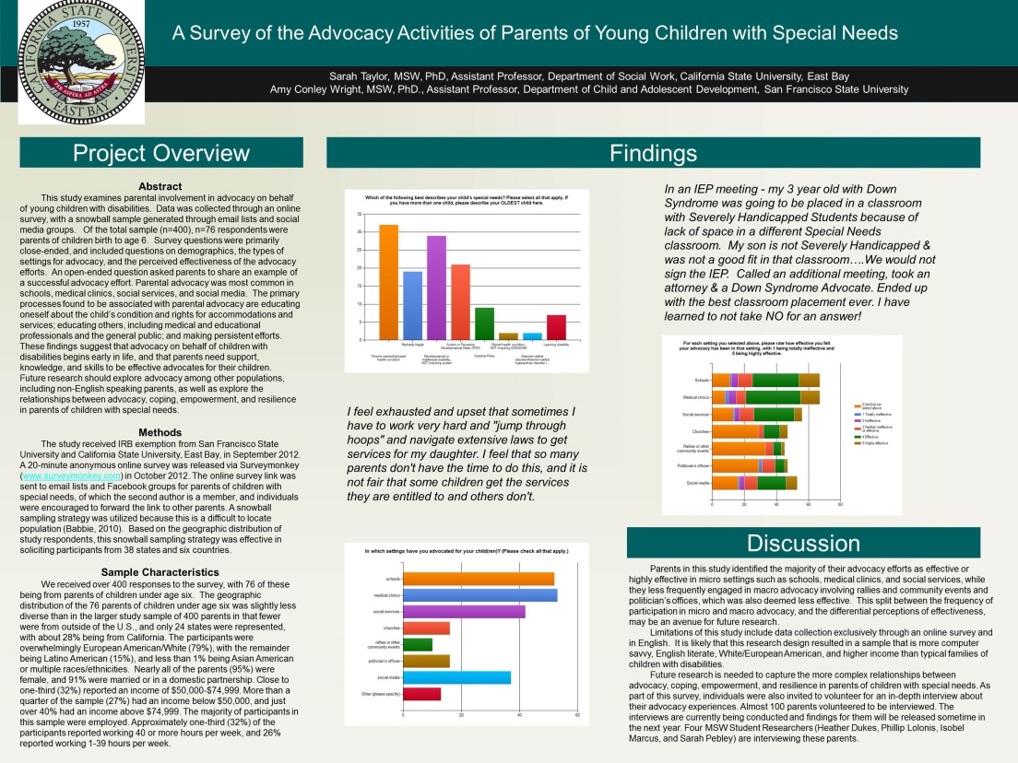
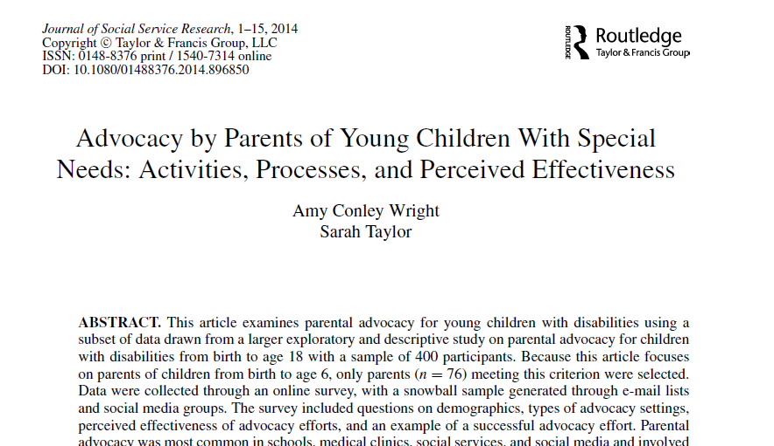
Research progress
Online survey of 463 (~300 completed most of the survey) parents of kids with special needs, including some international representation
In-depth phone interviews with 40 parents
Presented two posters at conferences
Published a paper on a subset of the survey data focused on the experiences of 76 parents of kids under age 6.

Slide 28
Themes in “Anything you want to tell us” Responses – Parents of Young Children
Needs for support, knowledge, and skill.
I think there needs to be more opportunities for parents to gather together to talk, share ideas, get support from one another. No one, unless you are another parent of a child with special needs, understands what it feels like, how difficult it is, what the challenges are. It can feel very isolating…
Sharing frustrations.
It is very challenging to advocate for your child and the school system fights you every step of the way. I naively felt they were there to help me and wish that someone would have told me that in fact their goal is to restrict services as much as possible. It is exhausting and frustrating.

Slide 29
Themes in “Anything you want to tell us” Responses – Parents of Teens
Advice!
Be educated about the subject and local process. Be assertive!
Comments on mezzo and macro advocacy.
It's all about the funding - we have to raise awareness in order to get the money to find better treatments and a cure.
Declarative statements.
Advocacy in schools is a giant rat maze…

Slide 30
Key survey findings
Parents advocate in a wide variety of settings.
Advocacy goals include obtaining access to appropriate services, increasing inclusion opportunities, raising public awareness about disability issues, and changing policies.
Advocacy work is time consuming and stressful for some (Many? Most?) parents.
Over time, parents advocate in more community and political settings and they feel their impact is greater.

Slide 31
Next Steps
Need more data on the journey.
How long does it take for it to get better?
How can we speed up the process of adaptation?
How can we best support people through the rough first few years?
How can we take advantage of the expertise of parents of teens and adults?
How can we support parents of young children to advocate through the exhaustion?
How can our systems make the whole process less stressful?
How can we build support networks that work for all kinds of families?
Explore and evaluate interventions designed to support parents and help them to be more effective advocates.
But leery of further clientizing parents or adding more people to the team…

Slide 32
Discussion Questions
What kinds of cause advocacy have you engaged in?
What kinds of cause advocacy would you like to try?
What challenges have you encountered, or do you foresee?
What have been your biggest advocacy successes on a case or cause level?

Slide 33
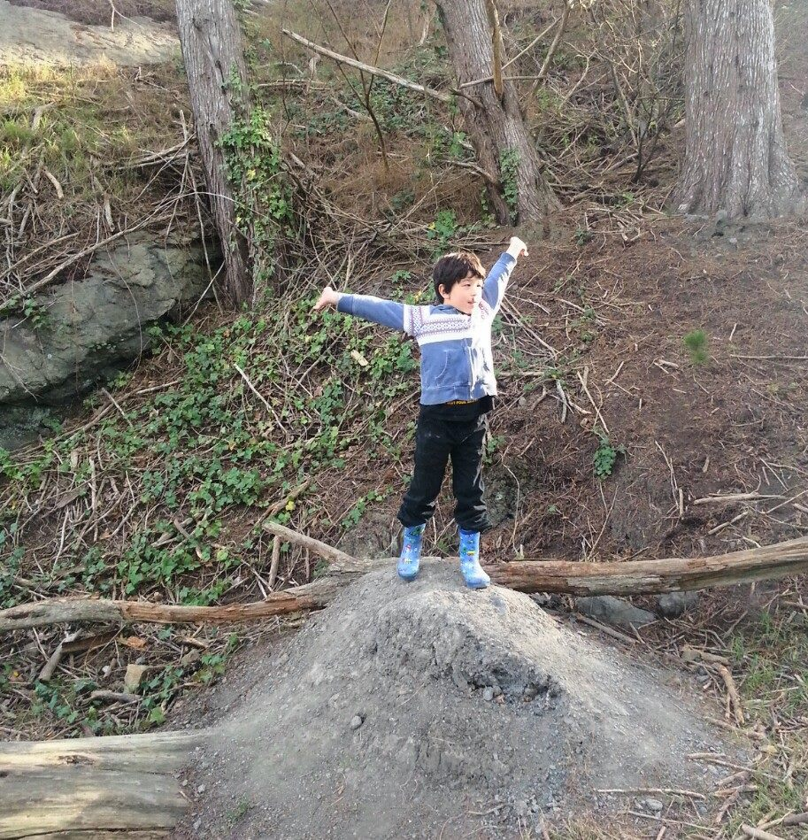
Questions?
Contact: Sarah Taylor, MSW, PhD
sarah.taylor@csueastbay.edu

Slide 34
Appendix

Slide 35
References
Conley Wright, A. & Taylor, S. (2014). Advocacy by parents of young children with special needs: Activities, processes, and perceived effectiveness. ﻿Journal of Social Service Research. Advance online publication. doi 10.1080/01488376.2014.896850
Cousino, M. K., & Hazen, R. A. (2013). Parenting stress among caregivers of children with chronic illness: a systematic review. Journal of pediatric psychology
Divorce among parents of children with autism: Dispelling urban legends. (2013). Autism, 17(6).
Hartley, S. L., Barker, E. T., Seltzer, M. M., Floyd, F., Greenberg, J., Orsmond, G., & Bolt, D. (2010). The relative risk and timing of divorce in families of children with an autism spectrum disorder. Journal of Family Psychology, 24(4).
Lavelle, T. A., Weinstein, M. C., Newhouse, J. P., Munir, K., Kuhlthau, K. A., & Prosser, L. A. (2014). Economic burden of childhood autism spectrum disorders. Pediatrics, 133(3), e520-e529.
Litzelman, K., Witt, W. P., Gangnon, R. E., Nieto, F. J., Engelman, C. D., Mailick, M. R., & Skinner, H. G. (2014). Association Between Informal Caregiving and Cellular Aging in the Survey of the Health of Wisconsin: The Role of Caregiving Characteristics, Stress, and Strain. American journal of epidemiology
Seltzer, M. M., Floyd, F., Song, J., Greenberg, J., & Hong, J. (2011). Midlife and aging parents of adults with intellectual and developmental disabilities: impacts of lifelong parenting. American journal on intellectual and developmental disabilities, 116(6), 479-499.
Singer, G. H. (2006). Meta-analysis of comparative studies of depression in mothers of children with and without developmental disabilities. American Journal on Mental Retardation, 111(3).

Slide 36
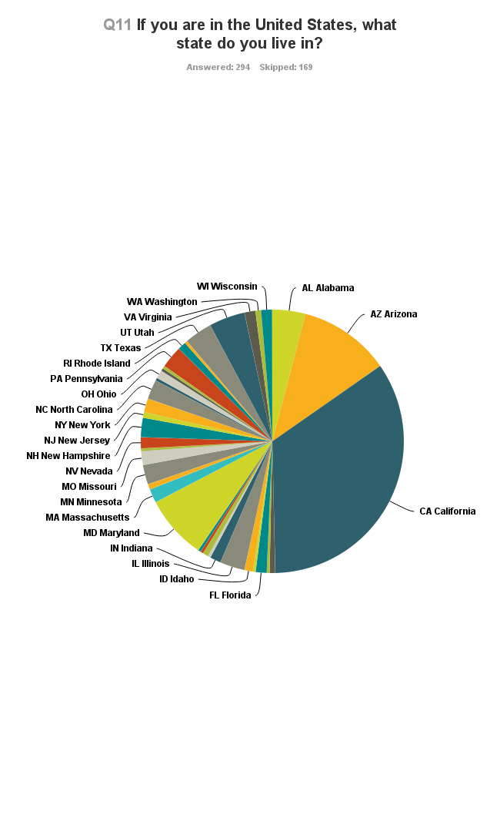
Characteristics of parents who completed the survey (n=304)
Age:
17% ages 26-35
35% ages 36-45
37% ages 46-55
11% under 26 or over 55
Vast majority from US, but tiny bit of representation from Australia, Canada, Spain, United Kingdom, Hungary, India, Philippines, Saudi Arabia, and United Arab Emirates.
Overwhelmingly female, white, and married.
Household income:
24% less than $50,000
37% between $50-100,000
39% more than $100,000
Employment status:
36% 40+ hours/week
20% 21-39 hours/week
12% 1-20 hours/week

Slide 37
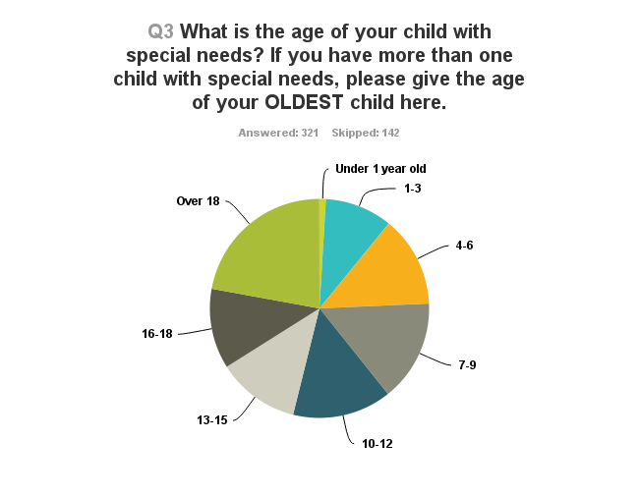
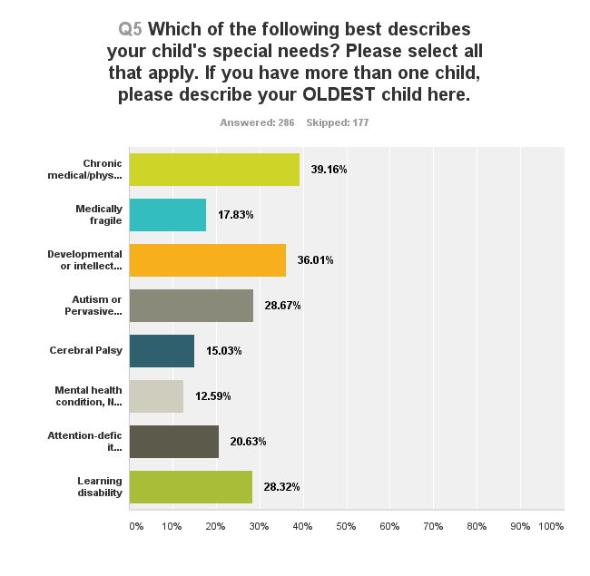
Ages and Special Needs of Children whose Parents Completed the Survey (n=321)

Slide 38
Advocacy Settings & Perceived Effectiveness – Parents of Young Children
Table 1 Settings in which Parents Advocated and Self-Perceptions of the Effectiveness of Advocacy Efforts (n=76)
 | Percent that advocated in this setting | Perception of effectiveness of advocacy in this setting, by percent
 |  | Not applicable | Totally ineffective | Ineffective | Neither ineffective or effective | Effective | Highly effective
Schools | 71.2 | 16.4 | 1.5 | 6.0 | 13.4 | 43.3 | 19.4
Medical clinics | 72.6 | 11.9 | 3.0 | 7.4 | 9.0 | 50.8 | 17.9
Social services | 57.5 | 23.2 | 1.8 | 5.3 | 16.1 | 44.6 | 9.0
Churches | 21.9 | 61.7 | 0.0 | 0.0 | 6.4 | 21.2 | 10.6
Rallies/community events | 13.7 | 73.3 | 0.0 | 0.0 | 11.1 | 11.1 | 4.4
Politician’s offices | 21.9 | 61.7 | 4.3 | 0.0 | 17.0 | 12.8 | 4.3
Social media | 50.7 | 30.2 | 2.0 | 5.7 | 15.1 | 34.0 | 13.2

Slide 39
Advocacy Settings & Perceived Effectiveness – Parents of Youth Ages 13-18
Table 2 Settings in which Parents Advocated and Self-Perceptions of the Effectiveness of Advocacy Efforts (n=77). More than parents of young children in this setting. Less than parents of young children in this setting.
 | Percent that advocated in this setting | Perception of effectiveness of advocacy in this setting, by percent
 |  | Not applicable | Totally ineffective | Ineffective | Neither ineffective or effective | Effective | Highly effective
Schools | 96.0 | 0.0 | 4.1 | 11.0 | 8.2 | 56.2 | 20.6
Medical clinics | 69.3 | 9.7 | 0.0 | 0.0 | 16.1 | 51.6 | 22.6
Social services | 48.0 | 24.5 | 0.0 | 9.4 | 9.4 | 41.5 | 15.1
Churches | 40.0 | 37.3 | 5.9 | 4.0 | 9.8 | 29.4 | 13.7
Rallies/community events | 33.3 | 38.8 | 2.0 | 2.0 | 20.4 | 26.5 | 10.2
Politician’s offices | 36.0 | 37.5 | 2.1 | 8.3 | 18.8 | 18.8 | 14.6
Social media | 37.3 | 35.4 | 2.1 | 4.2 | 18.8 | 29.2 | 10.4

